Slide 1
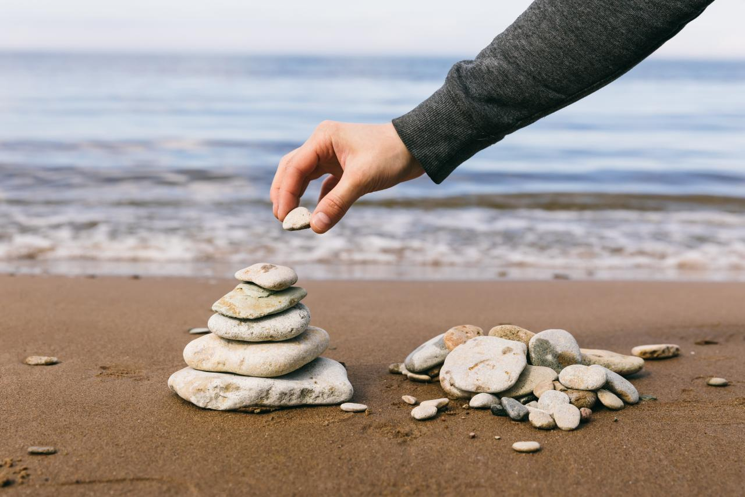

Everyday Mindfulness
Session 9
Mindfulness for Work & Career
Your Logo
with Your Name

Slide 2
Everyday Mindfulness
Session 9
Mindfulness for Work & Career
Your Logo
with Your Name

Slide 3

Bringing mindfulness to work is an act of self-care, a commitment to integrity. It makes you a better person to work with and it makes your work better.
Sharon Salzberg
Notes:
a psychological response to stimuli in the body and brain.

Slide 4
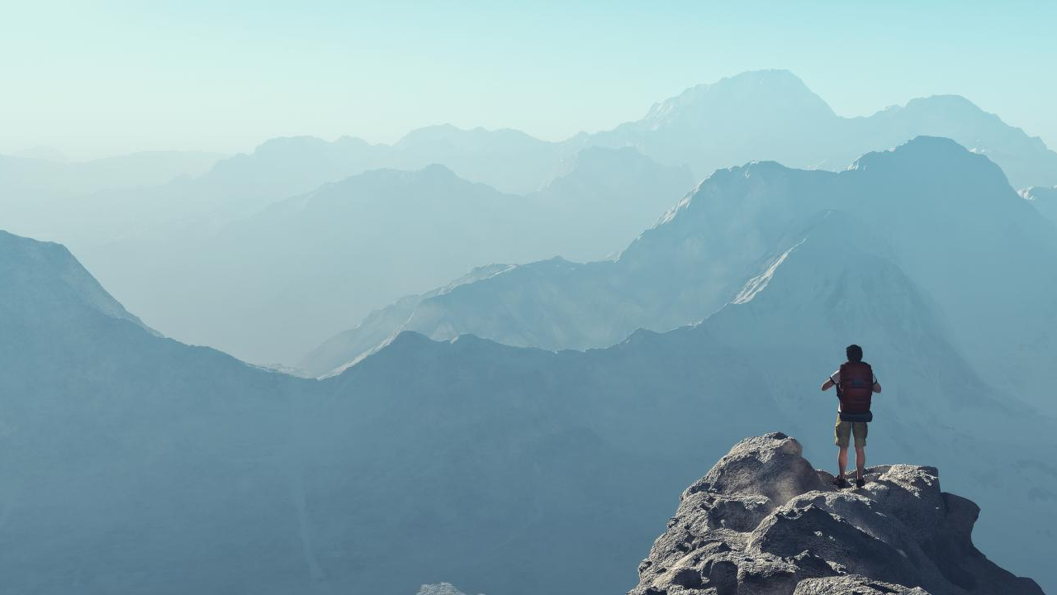
Balance is the first pillar of happiness in the workplace, because without it, it’s hard to do a good job or enjoy our work.
Sharon Salzberg
Notes:
a psychological response to stimuli in the body and brain.

Slide 5

BALANCE
My Goal: _________________________
Column 1: List everything over which you hold direct control.
Column 2: List everyone else who holds some control, input, or decision-making power.
Column 3: List all the factors over which no one holds any control.

Slide 6

REFLECTION
How does it feel to compare our direct realm of control with all the people and things outside our control?
How often do we feel responsible for other people and forces?
How does taking on all that responsibility feel?

Slide 7

Guided Practice: Balance Meditation

Slide 8

REFLECTION
Where in the body was more balance needed?
Where in the mind was more balance needed?
What patterns or themes were noticeable in the places more balance was needed today?

Slide 9

Guided Practice: Seeing the Good

Slide 10

REFLECTION
Write down or quietly reflect on all things you are grateful for.
Call to mind the people and gifts that make you thankful. Hold them in mind, savor them, and offer gratitude for each one.
Wish each person well.

Slide 11

Break

Slide 12
Guided Practice: Interconnectedness

Slide 13

MINDFULNESS OF SPEECH
Reframe the accusing “you” to the accountable “I”
Notes:
a psychological response to stimuli in the body and brain.

Slide 14

Anxiety Brainstorm
What thoughts do you associate with anxiety?
What emotions do you associate with anxiety?
What physical sensations do you associate with anxiety?

Slide 15
Guided Practice: Yes or No

Slide 16

Reflection
Use movement to reflect on the Yes or No Meditation.
Come back in 3 minutes to share with the group.

Slide 17
Guided Practice: Forgiveness

Slide 18

Closing Notes
Student Workbook practices for this week
Next session is at TIME/DATE/LOCATION
Final announcements

Slide 19

Closing
Wish each other and
ourselves well.

