Slide 1
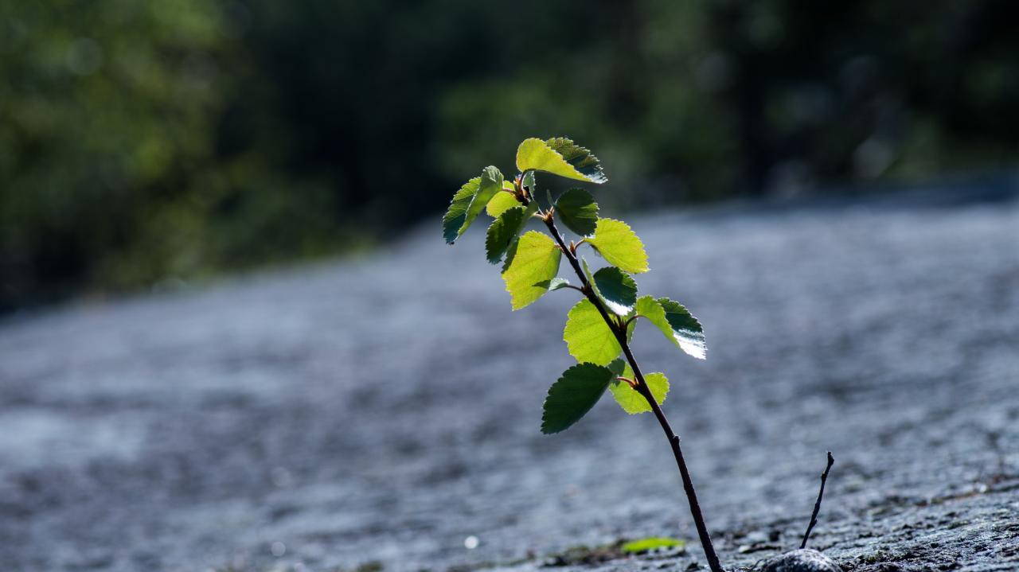

Everyday Mindfulness
Session 7
Resilience
Your Logo
with Your Name

Slide 2
Everyday Mindfulness
Session 7
Resilience
Your Logo
with Your Name

Slide 3
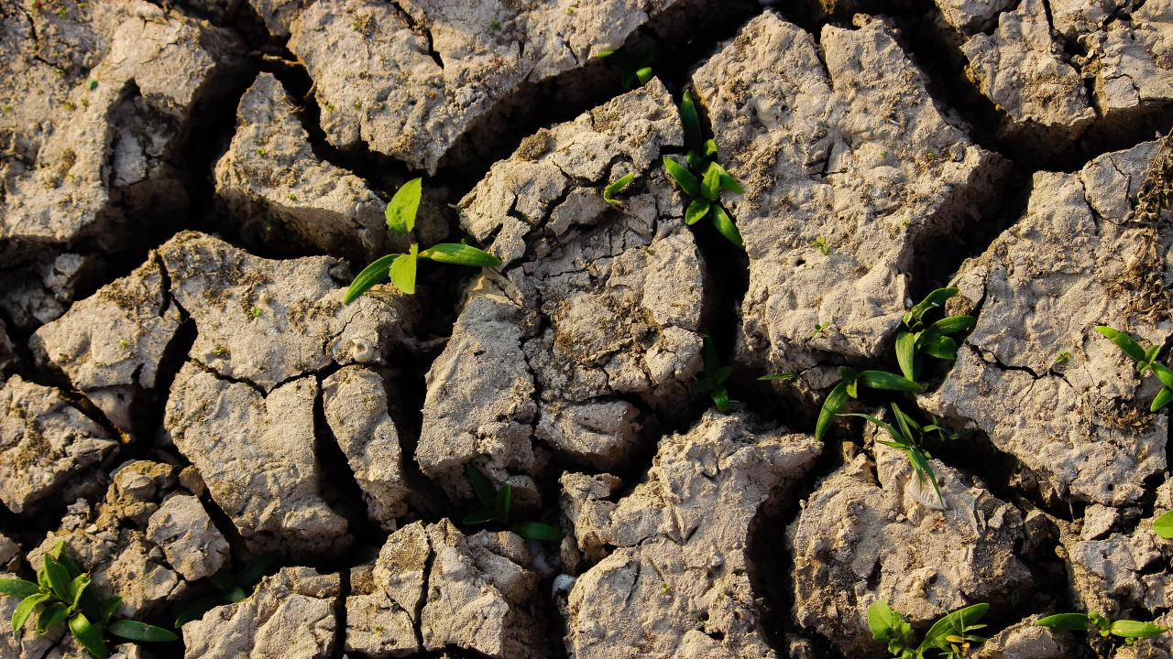
Resilience
Capacity to recover from failure, difficulty, disappointment, change, surprise, or hardship.
Notes:
a psychological response to stimuli in the body and brain.

Slide 4
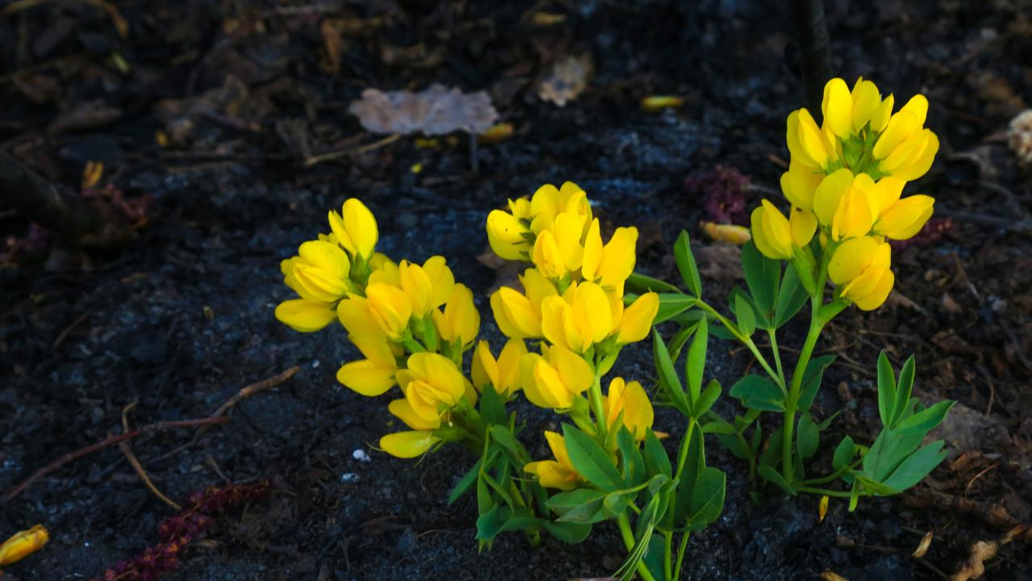
Emotional Resilience Cognitive Resilience Inner Calm (equanimity)

Slide 5
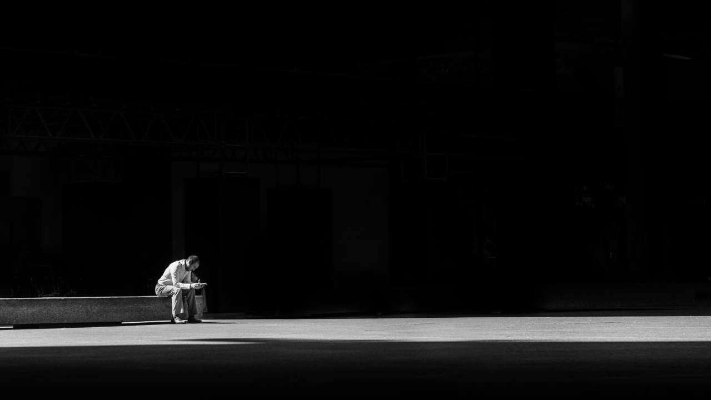
Partner Sharing
On setbacks, failures, and disappointments
Share a past disappointment, setback, or failure (in any life area).
Share a current aspiration.

Slide 6

Guided Practice: Emotional Resilience

Slide 7

Reflection
On emotional resilience
Compare the feelings about the failure/setback/disappointment and the feelings behind the negative self-talk.
How are the feelings similar and/or different?
Are they located in similar or different areas of the body?
How and where do you feel strength in the body?

Slide 8

Anchor Phrases
Notes:
a psychological response to stimuli in the body and brain.

Slide 9

Break

Slide 10

R.A.I.N.
Notes:
a psychological response to stimuli in the body and brain.

Slide 11

Recognize Acknowledge Investigate Non-Identify
Notes:
a psychological response to stimuli in the body and brain.

Slide 12

Guided Practice: Drawing on Inner Strength

Slide 13

Reflective Journaling
What inner strength and resources from the past are helpful now?
What resources missing in the past can now be incorporated into new and future inner strength?

Slide 14

Resilience for Caretaking
May I offer care and presence without conditions or expectations.
May I find the inner resources to be able to truly give.
May I offer love, knowing I can’t control the course of life, suffering, or death.
I care about your pain yet cannot control it.
I wish you happiness and peace but cannot make choices for you.
May I recognize my limits compassionately, just as I recognize the limitations of others.

Slide 15
Guided Practice: R.A.I.N.

Slide 16
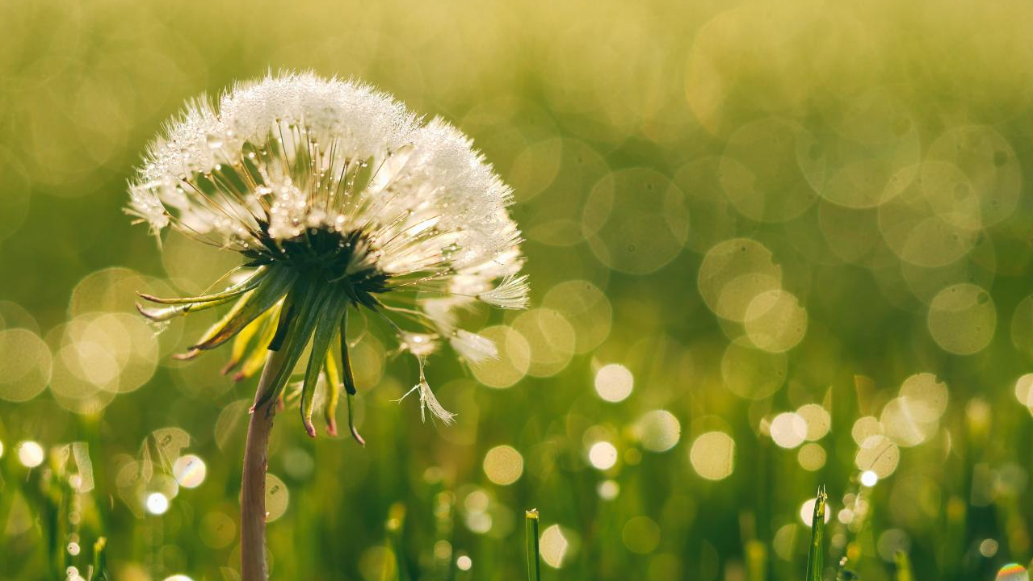
Reflection
On R.A.I.N.
What does it feel like to want something for another person?
What does it feel like when another person wants something for us?

Slide 17

Closing Notes
Student Workbook practices for this week
Next session is at TIME/DATE/LOCATION
Final announcements

Slide 18

Closing
Wish each other and
ourselves well.

