Slide 1
Everyday Mindfulness
Session 6
Mindfulness for
Communication & Leadership
Your Logo
with Your Name

Slide 2
Everyday Mindfulness
Session 6
Mindfulness for
Communication & Leadership
Your Logo
with Your Name

Slide 3
Mindful Relationships
How to talk, listen, connect, and lead mindfully.
Notes:
a psychological response to stimuli in the body and brain.

Slide 4
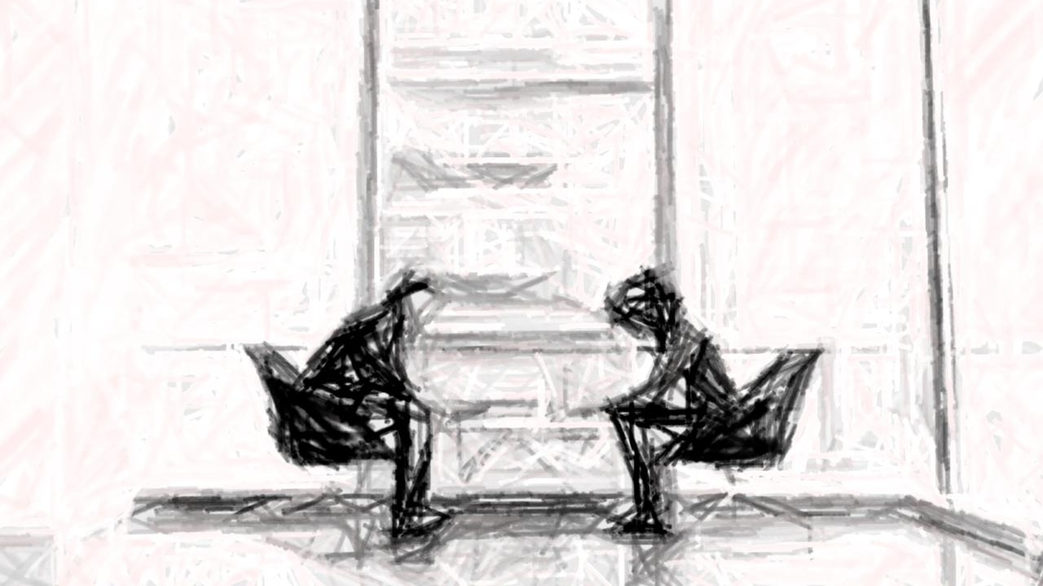
Difficult Conversations

Slide 5
3 LEVELS OF DIFFICULT CONVERSATIONS
Content, Feelings, Identity

Slide 6
Partner Exercise Difficult Conversations

Slide 7
Step 1
Partner Exercise: Difficult Conversations
Think of a difficult conversation you’ve had or need to have. Share with your partner your perspective:
What was the content?
What feelings arose?
What did the conversation say about your identity?

Slide 8
Step 2
Describe the same difficult conversation to your partner from the other person’s perspective.
Content
Feelings
Identity
Notes:
Give students 10 seconds to respond to each prompt before clicking to the next one.

Slide 9
Reflective Journaling
What changed between your 2 descriptions of the same conversation?
What surprised you or your partner during the activity?

Slide 10
Preparing
For Difficult Conversations
3 Levels Check intentions Third Story Listen Problem Solve
Notes:
a psychological response to stimuli in the body and brain.

Slide 11
Break

Slide 12
Guided Practice: Just Like Me

Slide 13
Reflection
On Just Like Me
What was it like to focus attention on a person during a practice?
What sense of connection might have developed from the practice?

Slide 14
Compassion
(n): the capacity to be attentive to the experience of others, to wish the best for others, and sense what will truly serve others.
Notes:
a psychological response to stimuli in the body and brain.

Slide 15
Empathetic distress
Taking on other people’s distress.
Becoming activated.
Over-identifying.
Burnout.

Slide 16
Guided Practice: Compassion

Slide 17
Reflection
On Compassion
When meditating on “true service,” what words and feelings arose?
Is there a clear direction for true service in your situation?

Slide 18
Closing Notes
Student Workbook practices for this week
Next session is at TIME/DATE/LOCATION
Final announcements

Slide 19
Closing
Wish each other and
ourselves well.

