Slide 1
Everyday Mindfulness with Your Name
Your Logo
Session 6
Mindfulness for
Communication & Leadership

Slide 2
How to talk, listen, connect, and lead mindfully.
Mindful Relationships
Notes:
a psychological response to stimuli in the body and brain.

Slide 3
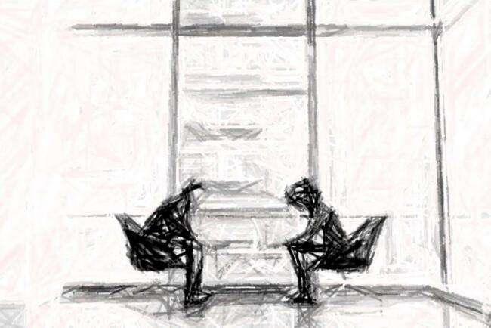
Difficult Conversations

Slide 4
3 Levels of Difficult Conversations
Content, Feelings, Identity

Slide 5
Partner Exercise Difficult Conversations

Slide 6
Step 1
Partner Exercise: Difficult Conversations
Think of a difficult conversation you’ve had or need to have. Share with your partner your perspective:
What was the content?
What feelings arose?
What did the conversation say about your identity?

Slide 7
Step 2
Describe the same difficult conversation to your partner from the other person’s perspective.
Content
Feelings
Identity
Notes:
Give students 10 seconds to respond to each prompt before clicking to the next one.

Slide 8
Reflective Journaling
What changed between your 2 descriptions of the same conversation?
What surprised you or your partner during the activity?

Slide 9
3 Levels Check intentions Third Story Listen Problem Solve
Preparing
for
Difficult Conversations
Notes:
a psychological response to stimuli in the body and brain.

Slide 10
Break

Slide 11
Guided Practice Just Like Me

Slide 12
Reflection
On Just Like Me
What was it like to focus attention on a person during a practice?
What sense of connection might have developed from the practice?

Slide 13
(n): the capacity to be attentive to the experience of others, to wish the best for others, and sense what will truly serve others.
Compassion
Notes:
a psychological response to stimuli in the body and brain.

Slide 14
Empathetic distress
Taking on other people’s distress.
Becoming activated.
Over-identifying.
Burnout.

Slide 15
Guided Practice: Compassion

Slide 16
Reflection
On Compassion
When meditating on “true service,” what words and feelings arose?
Is there a clear direction for true service in your situation?

Slide 17
Closing Notes
Student Workbook practices for this week
Next session is at TIME/DATE/LOCATION
Final announcements

Slide 18
Closing
Wish each other and
ourselves well.

