Slide 1
Everyday Mindfulness
Session 5
Loving Kindness & Compassion
Your Logo
with Your Name

Slide 2
Everyday Mindfulness
Session 5
Loving Kindness & Compassion
Your Logo
with Your Name

Slide 3
Loving Kindness
& Compassion
Empathy
Self-compassion
Self-kindness
Generosity
Care
Notes:
a psychological response to stimuli in the body and brain.

Slide 4
Self-Compassion
Warmth Acceptance
Common humanity

Slide 5
Benefits
Of loving kindness and self-compassion
Increases motivation to make amends, improve on a performance area, or strengthen a weakness
Increases growth mindset
Encourages confronting mistakes without shame or self-deprecation
Enables sustainable self-confidence

Slide 6
Giving Yourself Compassion for a Difficult Situation

Slide 7
Reflective Journaling
In which areas of my life can I be more forgiving?
What would change if I brought more forgiveness to these areas?

Slide 8
Inner Critic
Weakness Failure Obstacles
Threats
Mistakes
Judgement
Guilt
Shame
Anger
Hostility

Slide 9
Guided Practice: Identifying the Inner Critic

Slide 10
In what areas do you hear the inner critic most loudly?
What does the Inner Critic sound like? What does it say?
With a partner, share 1 and 2. When does the Inner Critic motivate, inspire, or support?
How would a loving friend respond to your Inner Critic?
What if we replaced the Inner Critic with that friend?
Notes:
Give students 10 seconds to respond to each prompt before clicking to the next one.

Slide 11
Break

Slide 12
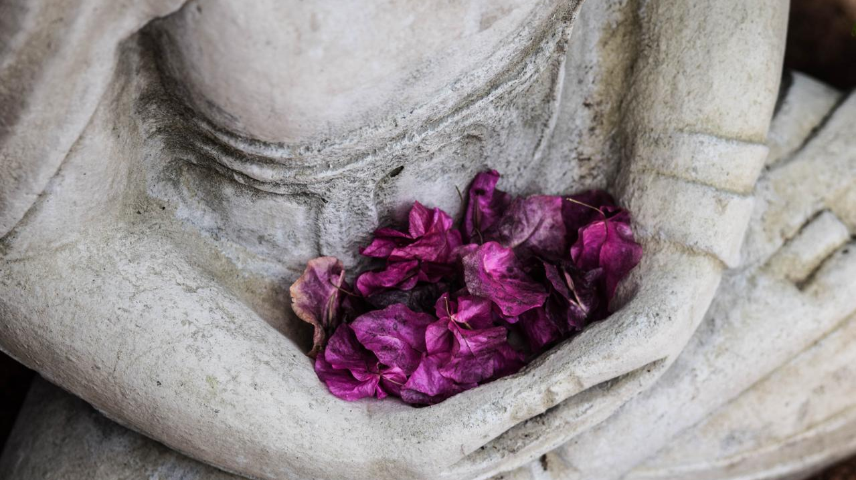
Loving Kindness
Self-Kindness
Warmth
Acceptance
Care
Soothing
Comfort
Pause
Notes:
a psychological response to stimuli in the body and brain.

Slide 13
Change the script Speak loving kindness to the inner critic

Slide 14
Guided Practice: Loving Kindness

Slide 15
Reflection
On Loving Kindness
What are the similarities and differences between self-kindness and comfort from external sources?
Neither is better. Just notice how they are alike and different.

Slide 16
Empathetic Listening Ground Rules

Slide 17
Empathetic
Listening
Choose any or all.
Talk about a current or past challenge in your life.
Talk about someone who is on your mind right now.
Talk about what brought you to this class.

Slide 18
Guided Practice: Steps to self-soothe

Slide 19
Closing Notes
Student Workbook practices for this week
Next session is at TIME/DATE/LOCATION
Final announcements

Slide 20
Closing
Wish each other and
ourselves well.

