Slide 1
Everyday Mindfulness
Session 4
Being with What’s Difficult
Your Logo
with Your Name

Slide 2
Everyday Mindfulness
Session 4
Being with What’s Difficult
Your Logo
with Your Name

Slide 3
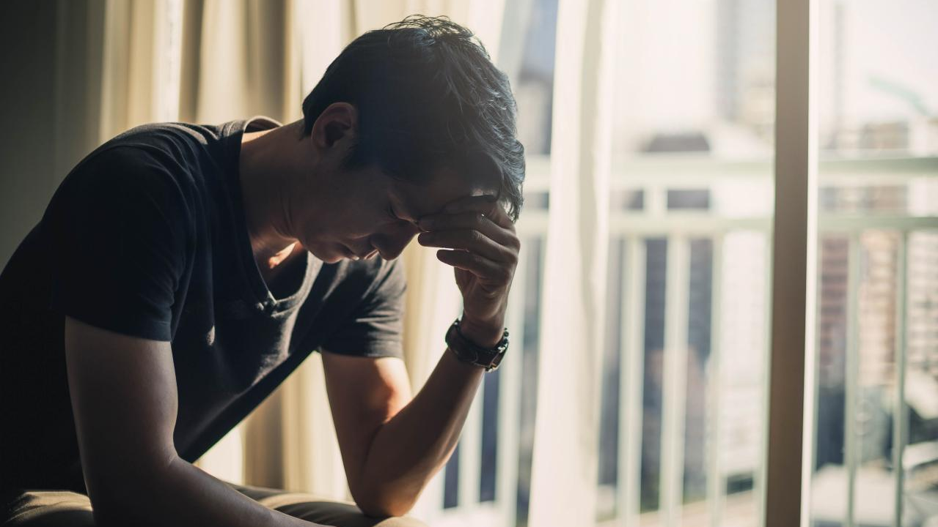
Tolerance (n): capacity, ability,
and strength of
mind to encounter pain, hardship,
or adversity

Slide 4
Judgement: Bad weather Observation: snow

Slide 5
Guided Practice: Awareness without Fixing

Slide 6
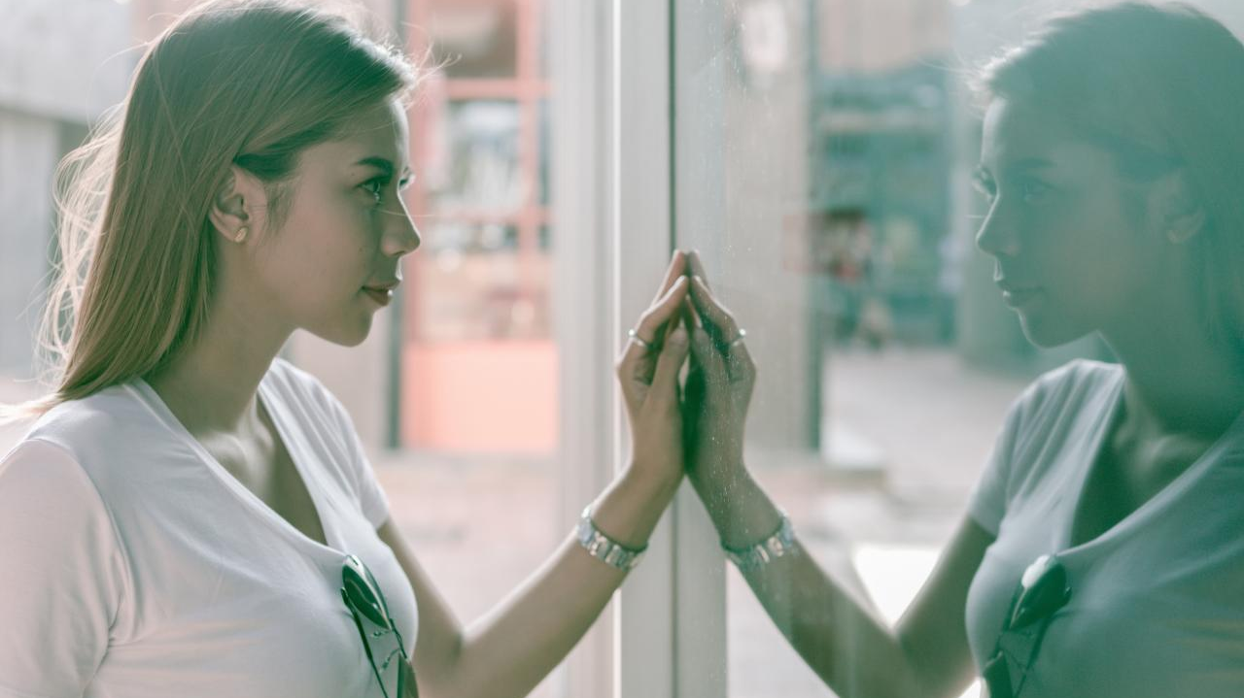
Reflection
On not fixing a “problem”
Describe how it felt to simply sit with a problem mindfully without trying to fix it.
Where in the body did the problem bring up sensations?
How does the “problem” feel or seem now?

Slide 7
Resistance

Slide 8
Guided Practice: Saying No to thoughts and emotions

Slide 9
Reflection
On resistance
Describe what it felt like to say “no” to the emotions and sensations of your scenario.
Describe anything that lingered after trying to resist.

Slide 10
Break

Slide 11
There will always be
Stress
Pain
Unpleasant ness

Slide 12
The
Unwanted Guest

Slide 13
How can we lessen our resistance to the unpleasant?

Slide 14
Guided Practice: Unpleasant-Neutral-Pleasant

Slide 15
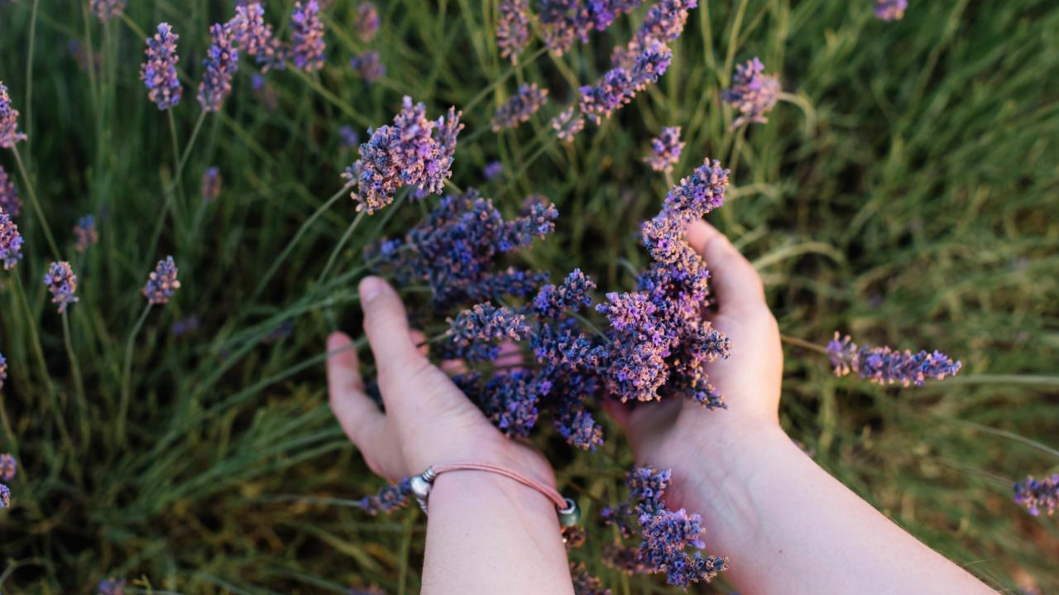
Reflection Journaling
What are the similarities and differences among unpleasant, neutral, and pleasant feelings and sensations?
Has anything changed from before the practice?
Notes:
Give students 10 seconds to respond to each prompt before clicking to the next one.

Slide 16
Guided Practice: Bringing Compassion to Difficult Emotions

Slide 17
Closing Notes
Student Workbook practices for this week
Next session is at TIME/DATE/LOCATION
Final announcements

Slide 18
Closing
Wish each other and
ourselves well.

