Slide 1
Everyday Mindfulness with Your Name
Your Logo
Session 4
Being with What’s Difficult

Slide 2
Tolerance (n): capacity, ability, and strength of mind to encounter pain, hardship, or adversity
Notes:
a psychological response to stimuli in the body and brain.

Slide 3
Judgement: Bad weather Observation: Snow

Slide 4
Guided Practice: Awareness without Fixing

Slide 5
Reflection
On not fixing a “problem”
Describe how it felt to simply sit with a problem mindfully without trying to fix it.
Where in the body did the problem bring up sensations?
How does the “problem” feel or seem now?

Slide 6
Resistance

Slide 7
Guided Practice: Saying No to thoughts and emotions

Slide 8
Reflection
On resistance
Describe what it felt like to say “no” to the emotions and sensations of your scenario.
Describe anything that lingered after trying to resist.

Slide 9
Break

Slide 10
There will always be stress pain unpleasant ness

Slide 11
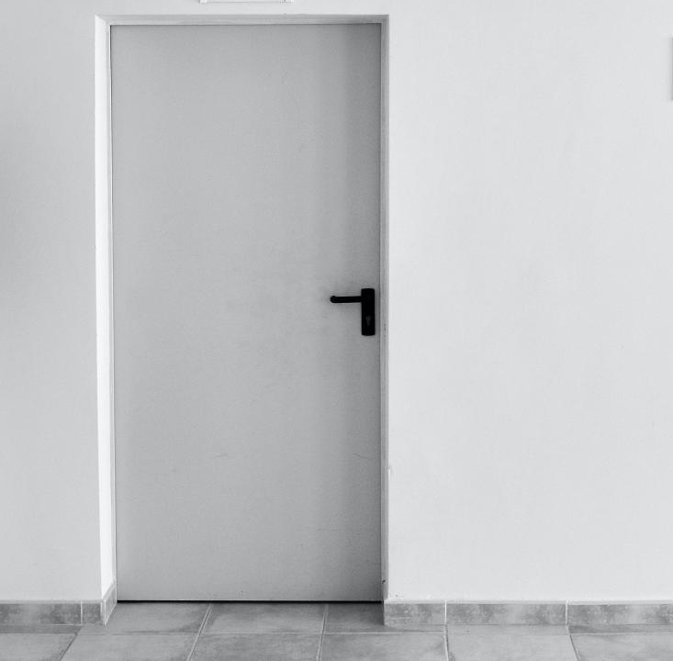
The Unwanted Guest

Slide 12
How can we lessen our resistance to the unpleasant?

Slide 13
Guided Practice: Unpleasant-Neutral-Pleasant

Slide 14
Reflection Journaling
What are the similarities and differences among unpleasant, neutral, and pleasant feelings and sensations?
Has anything changed from before the practice?
Notes:
Give students 10 seconds to respond to each prompt before clicking to the next one.

Slide 15
Guided Practice: Bringing Compassion to Difficult Emotions

Slide 16
Closing Notes
Student Workbook practices for this week
Next session is at TIME/DATE/LOCATION
Final announcements

Slide 17
Closing
Wish each other and
ourselves well.

