Slide 1


Everyday Mindfulness
Session 3
Mindfulness of Emotions
Your Logo
with Your Name

Slide 2
Everyday Mindfulness
Session 3
Mindfulness of Emotions
Your Logo
with Your Name

Slide 3

Emotion (n):
a psychological response to stimuli in the body and brain.

Slide 4

Emotions are . . .
Activated by stimuli
Responses to the body and mind
Part of the whole self
Normal and necessary

Slide 5


Emotional Responses
Write down the emotion each image elicits in you. There may be more than one.
There are no right or wrong answers, only your answers.
?

Slide 6


Slide 7
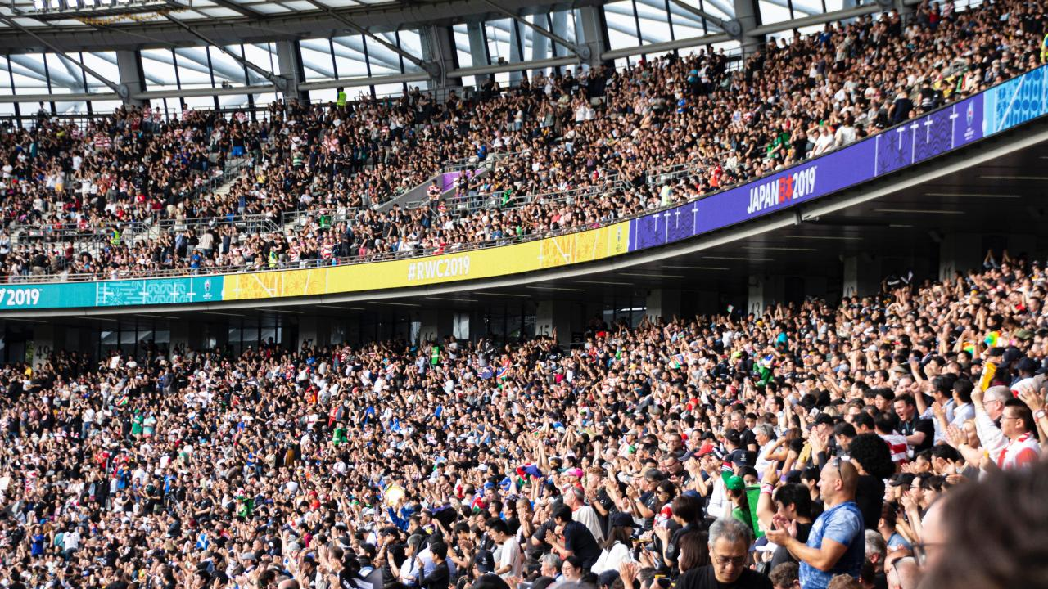

Slide 8


Slide 9


Slide 10
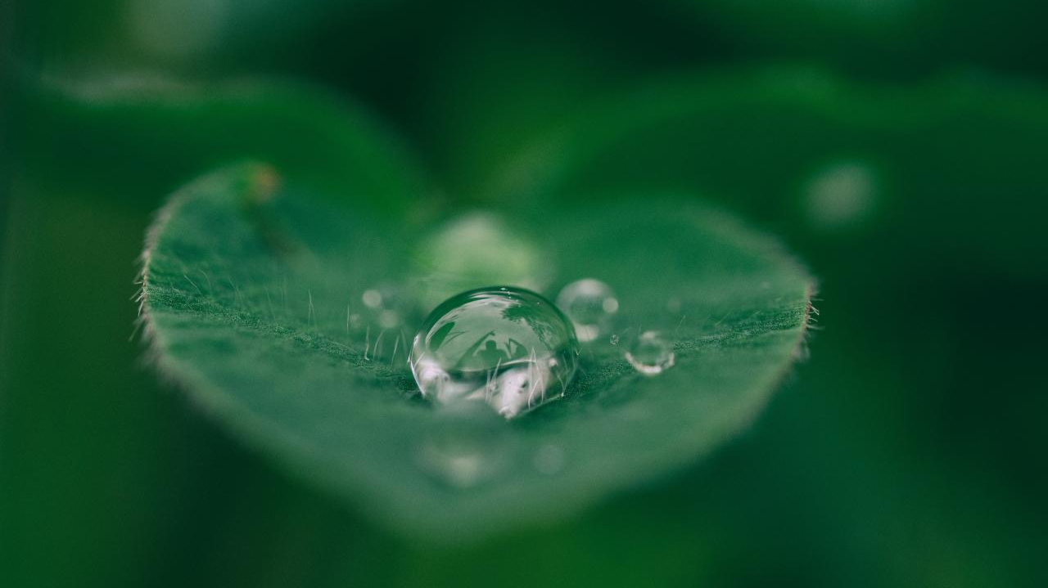
How do we live mindfully of our emotions, without allowing them to overwhelm or dictate?

Slide 11

We feel angry. We are not an angry person.
We feel tired. We are not a lazy person.
We feel afraid. We are not a fearful person.

Slide 12

Guided Practice: Sensing into our Emotions

Slide 13
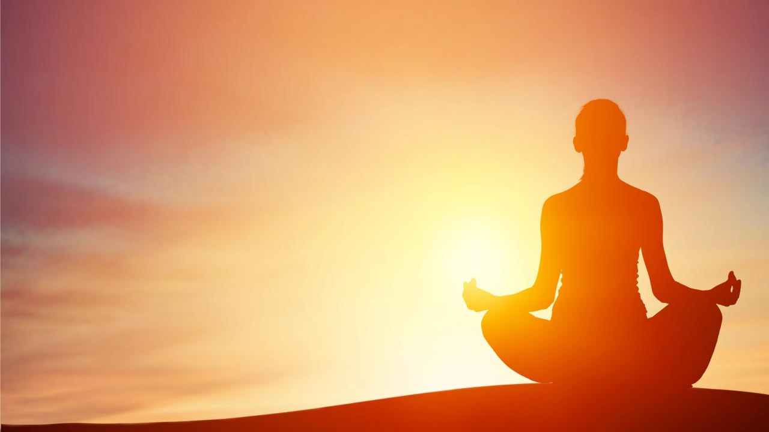
How do you notice the body and mind connected and disconnected?
What are the similarities and differences between pleasant and unpleasant emotions in the body?
?

Slide 14
Guided Practice: The (Emotional) Body Scan

Slide 15

Where are you aware of needing during emotionally-centered practices in order to feel safe, calm, secure, and/or focused?
?

Slide 16

Break

Slide 17

Emotional Journaling
I feel calm when . . .
I feel anxious when . . .
I feel angry when . . .
I feel excited when . . .
I feel afraid when . . .
I feel sad when . . .
I feel hopeful when . . .
Notes:
Give students 10 seconds to respond to each prompt before clicking to the next one.

Slide 18

Self-Management
For unpleasant experiences and emotions
Stop
Breathe
Notice
Reflect
Respond

Slide 19
Guided Practice: Managing Unpleasant Experiences and Emotions

Slide 20

Closing Notes
Student Workbook practices for this week
Next session is at TIME/DATE/LOCATION
Final announcements

Slide 21

Closing
Wish each other and
ourselves well.

