Slide 1
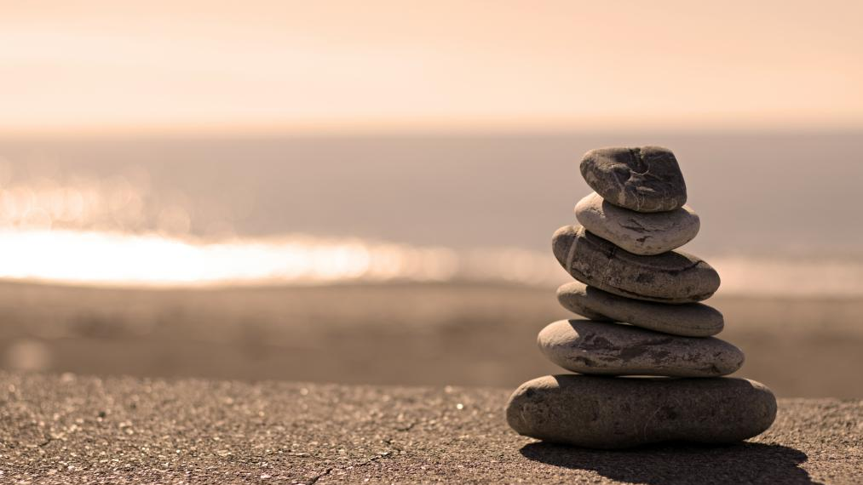
Everyday Mindfulness
Session 2
Mindfulness of the Body
Your Logo
with Your Name

Slide 2
Everyday Mindfulness
Session 2
Mindfulness of the Body
Your Logo
with Your Name

Slide 3
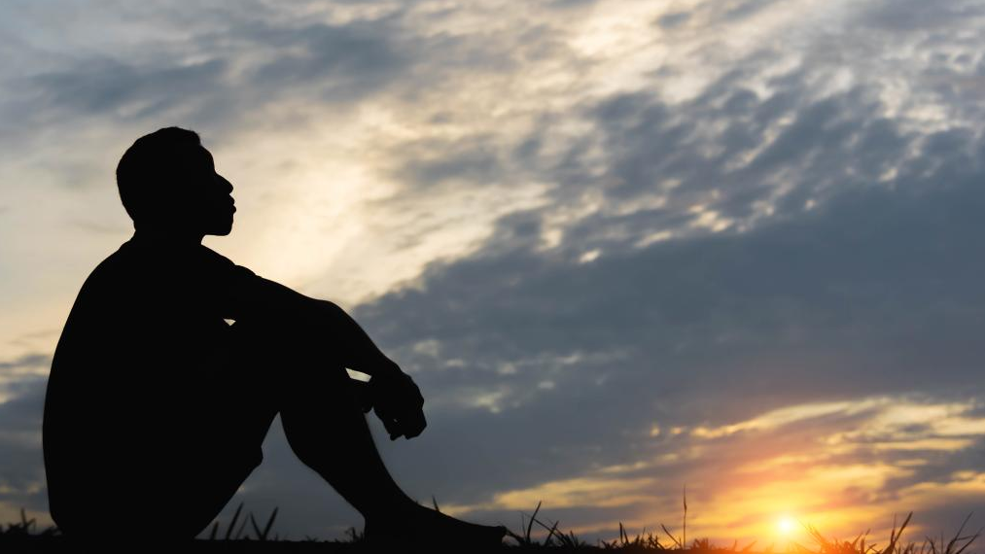
Pair Check In
What was most memorable about the previous session?
What experiences, positive or challenging, did you have with this week’s homework?
What are your intentions and goals for today’s class?
?

Slide 4
Grounding Exercise: Three Mindful Breaths

Slide 5
Mindfulness of the Body

Slide 6
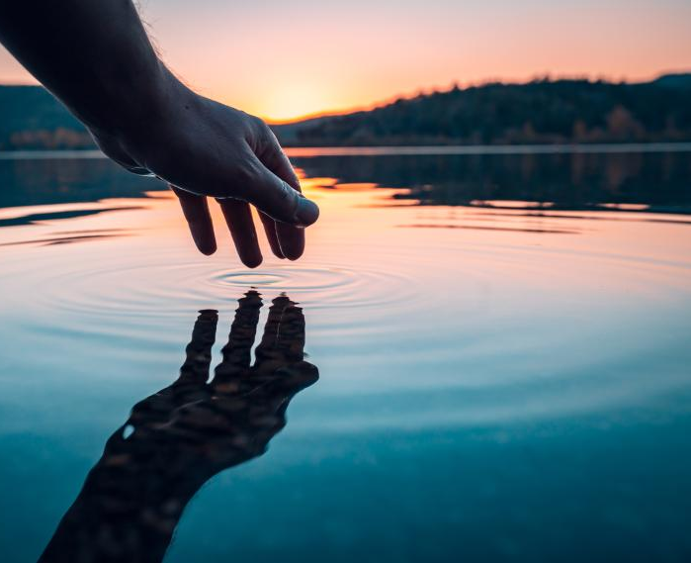
Self-Assessment
Mindfulness of the Body
Reflect on any reasons you may feel uncomfortable connecting mindfully with your body today.
Are there any specific regions of the body that you wish to avoid in today’s practices? Remember, you are empowered to connect with the body in ways that are safe and healing.
Any other notes, concerns, or reflections.

Slide 7
The Body Scan

Slide 8
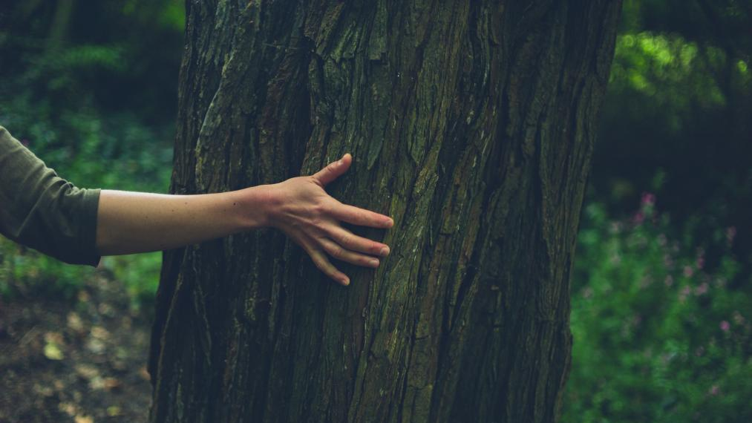
What physical sensations were brought to attention? Where?
What emotions were brought to attention? Where?
Did anything surprise you during or after the practice?
?

Slide 9
Making Room for Pain and Discomfort

Slide 10
Break

Slide 11
Outdoor Practices
Mindfulness of Sound: 10 minutes seated
Mindfulness of Walking: 10 minutes
Participate to your ability and comfort level
Stop at any time to rest
Bring water if needed

Slide 12
Labeling: Name it to tame it.

Slide 13
Labeling
Physical sensations and emotions
Recall the regions of the body brought to attention during today’s practices.
Recall the emotions brought to attention during today’s practices.
Using the list provided, label the sensations and emotions.

Slide 14
Closing Notes
Student Workbook practices for this week
Next session is at TIME/DATE/LOCATION
Final announcements

Slide 15
Closing
Wish each other and
ourselves well.

