Slide 1
Part 9.1
That Which Gets in the
Way of Your Task
Obstacle #2 - Distractions
Notes:
Welcome to this course, entitled Lessons in Gratitude.
I am Sean Fargo.
I am the Founder of Mindfulness Exercises.com, a former Buddhist monk, speaker and trainer on mindfulness.
The intention of this course is to share teachings in gratitude and to support you in deepening your exploration of gratitude in your life.

Slide 2
Photo by Priscilla Du Preez on Unsplash
Notes:
We have touched upon the lessons in survival that stem from our relationship with nature. There is a deep connection between the protections of the earth and social justice. What affects people in one part of the world affects the entire human family.
(Do not read Image https://pixabay.com/en/family-children-father-mother-1466262/)

Slide 3
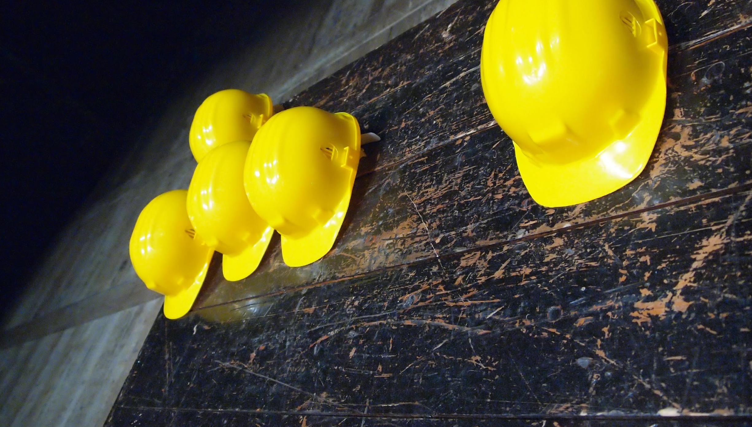
Photo by Silvia Brazzoduro on Unsplash
Notes:
We have touched upon the lessons in survival that stem from our relationship with nature. There is a deep connection between the protections of the earth and social justice. What affects people in one part of the world affects the entire human family.
(Do not read Image https://pixabay.com/en/family-children-father-mother-1466262/)

Slide 4
What do we do in this in this situation?

Slide 5
“Oh I can't meditate like this. This is too noisy in the environment. I need a quiet and peaceful place.”

Slide 6
Distractions we bring about ourselves;
like distracting thoughts and distracting emotions.

Slide 7
how to work with distractions of
any kind
In This Video
Notes:
Welcome to this course, entitled Lessons in Gratitude.
I am Sean Fargo.
I am the Founder of Mindfulness Exercises.com, a former Buddhist monk, speaker and trainer on mindfulness.
The intention of this course is to share teachings in gratitude and to support you in deepening your exploration of gratitude in your life.

Slide 8
No matter what the distraction is, we can work with it in the same way.

Slide 9
“That which gets in the way of your task, is your task.”

Slide 10
The thing that's blocking us from trying to meditate, is the thing we can use as the object of our meditation.

Slide 11
Photo by Natalia Figueredo on Unsplash
Notes:
We have touched upon the lessons in survival that stem from our relationship with nature. There is a deep connection between the protections of the earth and social justice. What affects people in one part of the world affects the entire human family.
(Do not read Image https://pixabay.com/en/family-children-father-mother-1466262/)

Slide 12
just allow your attention to go there, using the sound as the new object of meditation.
Photo by Natalia Figueredo on Unsplash
Notes:
We have touched upon the lessons in survival that stem from our relationship with nature. There is a deep connection between the protections of the earth and social justice. What affects people in one part of the world affects the entire human family.
(Do not read Image https://pixabay.com/en/family-children-father-mother-1466262/)

Slide 13
Focusing on Distractions
Next Video
Notes:
Welcome to this course, entitled Lessons in Gratitude.
I am Sean Fargo.
I am the Founder of Mindfulness Exercises.com, a former Buddhist monk, speaker and trainer on mindfulness.
The intention of this course is to share teachings in gratitude and to support you in deepening your exploration of gratitude in your life.

