Slide 1
Part 14.2
GUIDED MEDITATION:
Open Practice
Bringing it All Together
Notes:
Welcome to this course, entitled Lessons in Gratitude.
I am Sean Fargo.
I am the Founder of Mindfulness Exercises.com, a former Buddhist monk, speaker and trainer on mindfulness.
The intention of this course is to share teachings in gratitude and to support you in deepening your exploration of gratitude in your life.

Slide 2
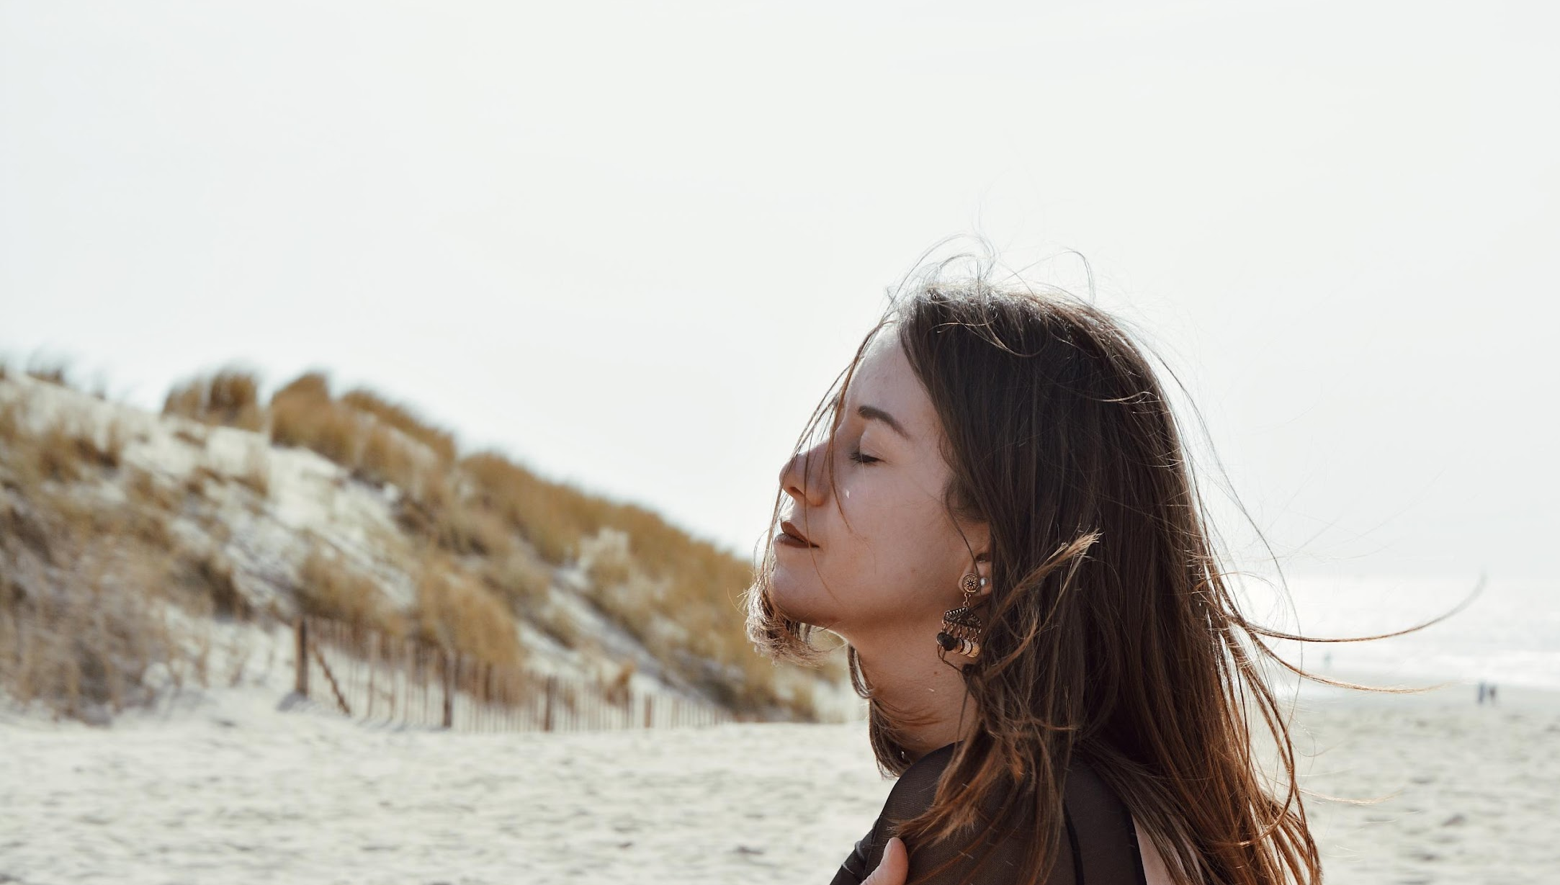
Photo by Amandine Lerbscher on Unsplash
Notes:
We have touched upon the lessons in survival that stem from our relationship with nature. There is a deep connection between the protections of the earth and social justice. What affects people in one part of the world affects the entire human family.
(Do not read Image https://pixabay.com/en/family-children-father-mother-1466262/)

Slide 3
If you wish to take a few deep breaths you can do so.
Photo by Amandine Lerbscher on Unsplash
Notes:
We have touched upon the lessons in survival that stem from our relationship with nature. There is a deep connection between the protections of the earth and social justice. What affects people in one part of the world affects the entire human family.
(Do not read Image https://pixabay.com/en/family-children-father-mother-1466262/)

Slide 4
Maybe giving yourself permission to just explore this meditation.

Slide 5
Letting go of any expectations of what should happen in this session.

Slide 6
notice where your mind is

Slide 7
What are you paying attention to?

Slide 8
bring your awareness to the feeling of the breath,

Slide 9
tapping into the raw physical sensations

Slide 10
practicing the body scan and just moving through the body,

Slide 11
being aware of different parts of the body piece by piece

Slide 12
keep bringing your attention back and asking

Slide 13
“What am I paying attention to?”

Slide 14
“Where is my mind?”

Slide 15
“And how am I relating to what's arising?”

Slide 16
No matter where you are, just seeing if you can practice and non-judgmental awareness.

Slide 17
Just observing.

Slide 18
Being patient and kind towards whatever arises.

Slide 19
The moment you realize that you've been lost in thought, seeing if you can acknowledge it without judging yourself.

Slide 20
coming back to the present moment patiently with gentleness just returning to whatever object of meditation you have chosen to work with

Slide 21
the breath or the body, sounds or thoughts and feelings

Slide 22
Noticing how are you relating to your experience?

Slide 23
Is there anything that you are judging?

Slide 24
Just practicing this calm equanimity.

Slide 25
Whenever you are unsure of what to do you can always bring your attention back to the feeling of the breath.

Slide 26
Just tapping into your direct experience of the present moment.

Slide 27
Is there anything distracting you in this moment?

Slide 28
allowing your attention to go observe what is distracting you

Slide 29
Non-judgmentally observing the present moment.

Slide 30
let go of any meditation practice

Slide 31
let go of mindfulness and just allow your mind to wander

Slide 32
Allow your mind to do whatever it wants.

Slide 33
And then we'll take a deep breath in to end.

Slide 34
Breathing in deeply

Slide 35
breathing out slow

Slide 36
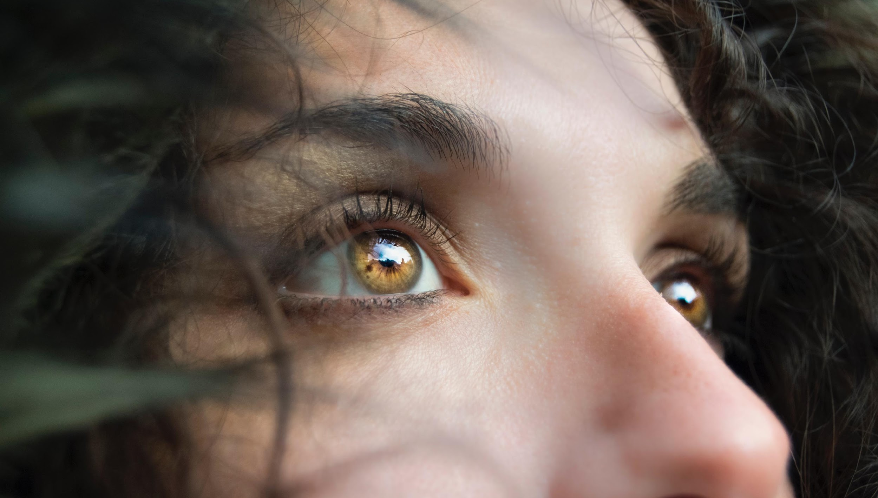
In your own time allowing your eyes to open.
Photo by Marina Vitale on Unsplash
Notes:
We have touched upon the lessons in survival that stem from our relationship with nature. There is a deep connection between the protections of the earth and social justice. What affects people in one part of the world affects the entire human family.
(Do not read Image https://pixabay.com/en/family-children-father-mother-1466262/)

Slide 37
Coming back into the room.
Photo by Marina Vitale on Unsplash
Notes:
We have touched upon the lessons in survival that stem from our relationship with nature. There is a deep connection between the protections of the earth and social justice. What affects people in one part of the world affects the entire human family.
(Do not read Image https://pixabay.com/en/family-children-father-mother-1466262/)

Slide 38
the obstacle of doubt and self
Next Video
Notes:
Welcome to this course, entitled Lessons in Gratitude.
I am Sean Fargo.
I am the Founder of Mindfulness Exercises.com, a former Buddhist monk, speaker and trainer on mindfulness.
The intention of this course is to share teachings in gratitude and to support you in deepening your exploration of gratitude in your life.

