Slide 1
Part 10.1
Hello, Old Friend
Difficult Emotions
Notes:
Welcome to this course, entitled Lessons in Gratitude.
I am Sean Fargo.
I am the Founder of Mindfulness Exercises.com, a former Buddhist monk, speaker and trainer on mindfulness.
The intention of this course is to share teachings in gratitude and to support you in deepening your exploration of gratitude in your life.

Slide 2
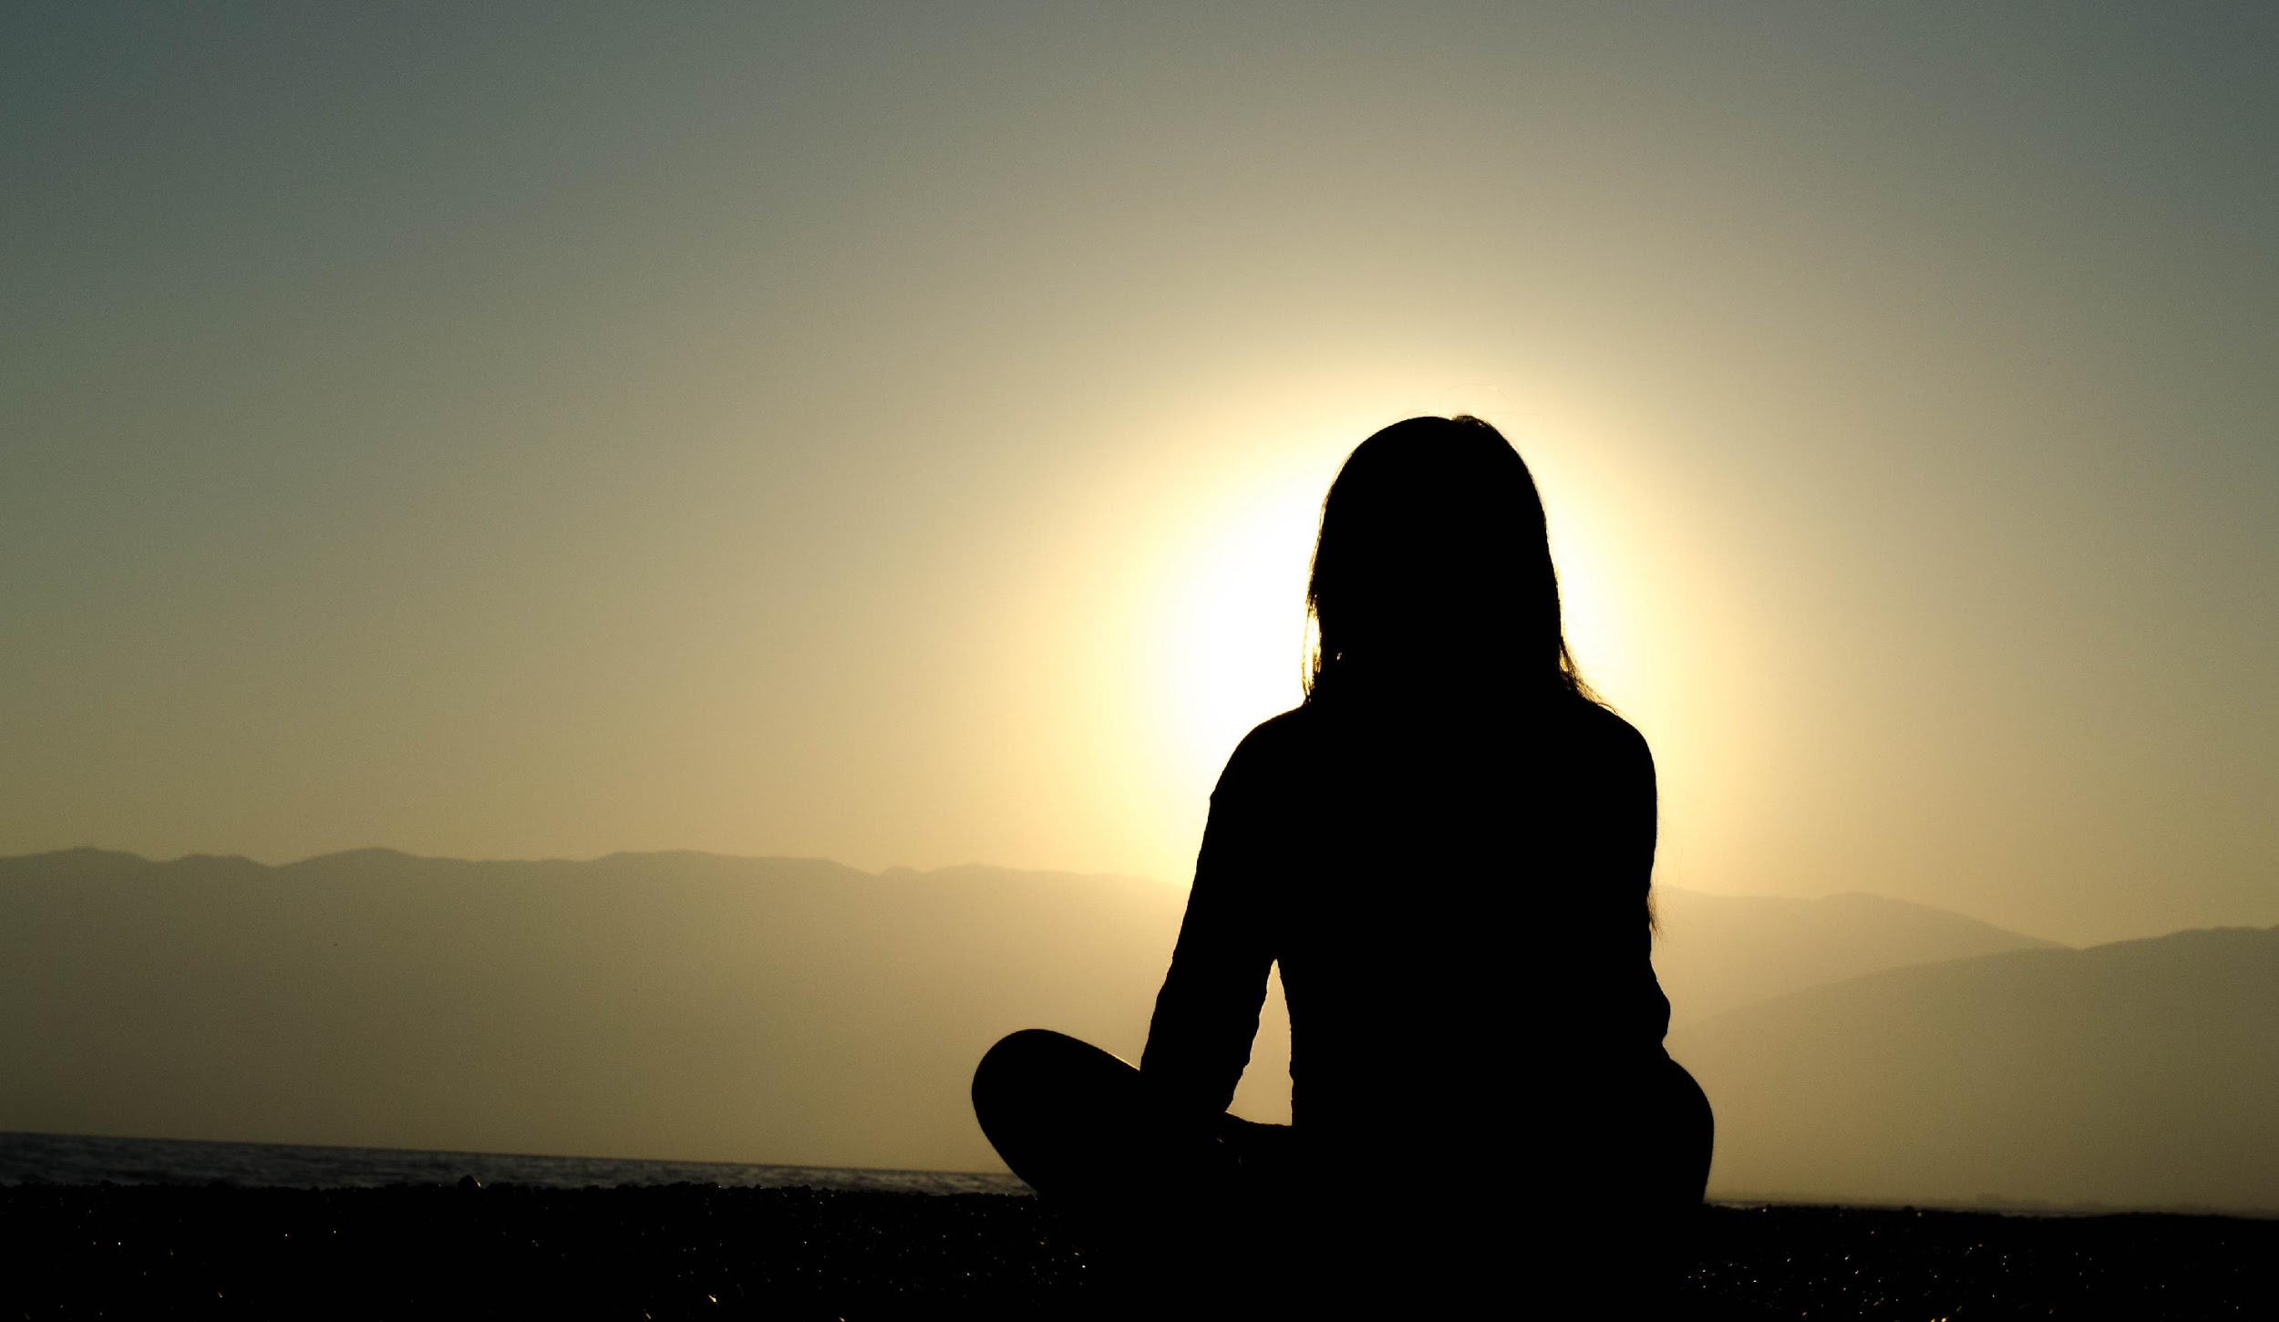
Photo by Dingzeyu Li on Unsplash
Notes:
We have touched upon the lessons in survival that stem from our relationship with nature. There is a deep connection between the protections of the earth and social justice. What affects people in one part of the world affects the entire human family.
(Do not read Image https://pixabay.com/en/family-children-father-mother-1466262/)

Slide 3
All sorts of emotions can come up that are really difficult to work with.
Photo by Dingzeyu Li on Unsplash
Notes:
We have touched upon the lessons in survival that stem from our relationship with nature. There is a deep connection between the protections of the earth and social justice. What affects people in one part of the world affects the entire human family.
(Do not read Image https://pixabay.com/en/family-children-father-mother-1466262/)

Slide 4
a technique that you can use for particularly nasty emotions and feelings

Slide 5
The basis for this practice is understanding that, that which we push away, gets stronger.

Slide 6
So the more we fight a particular emotion, the stronger they become.

Slide 7
If you're pushing sadness away

Slide 8
it's not going to go away, actually it just gets stronger.

Slide 9
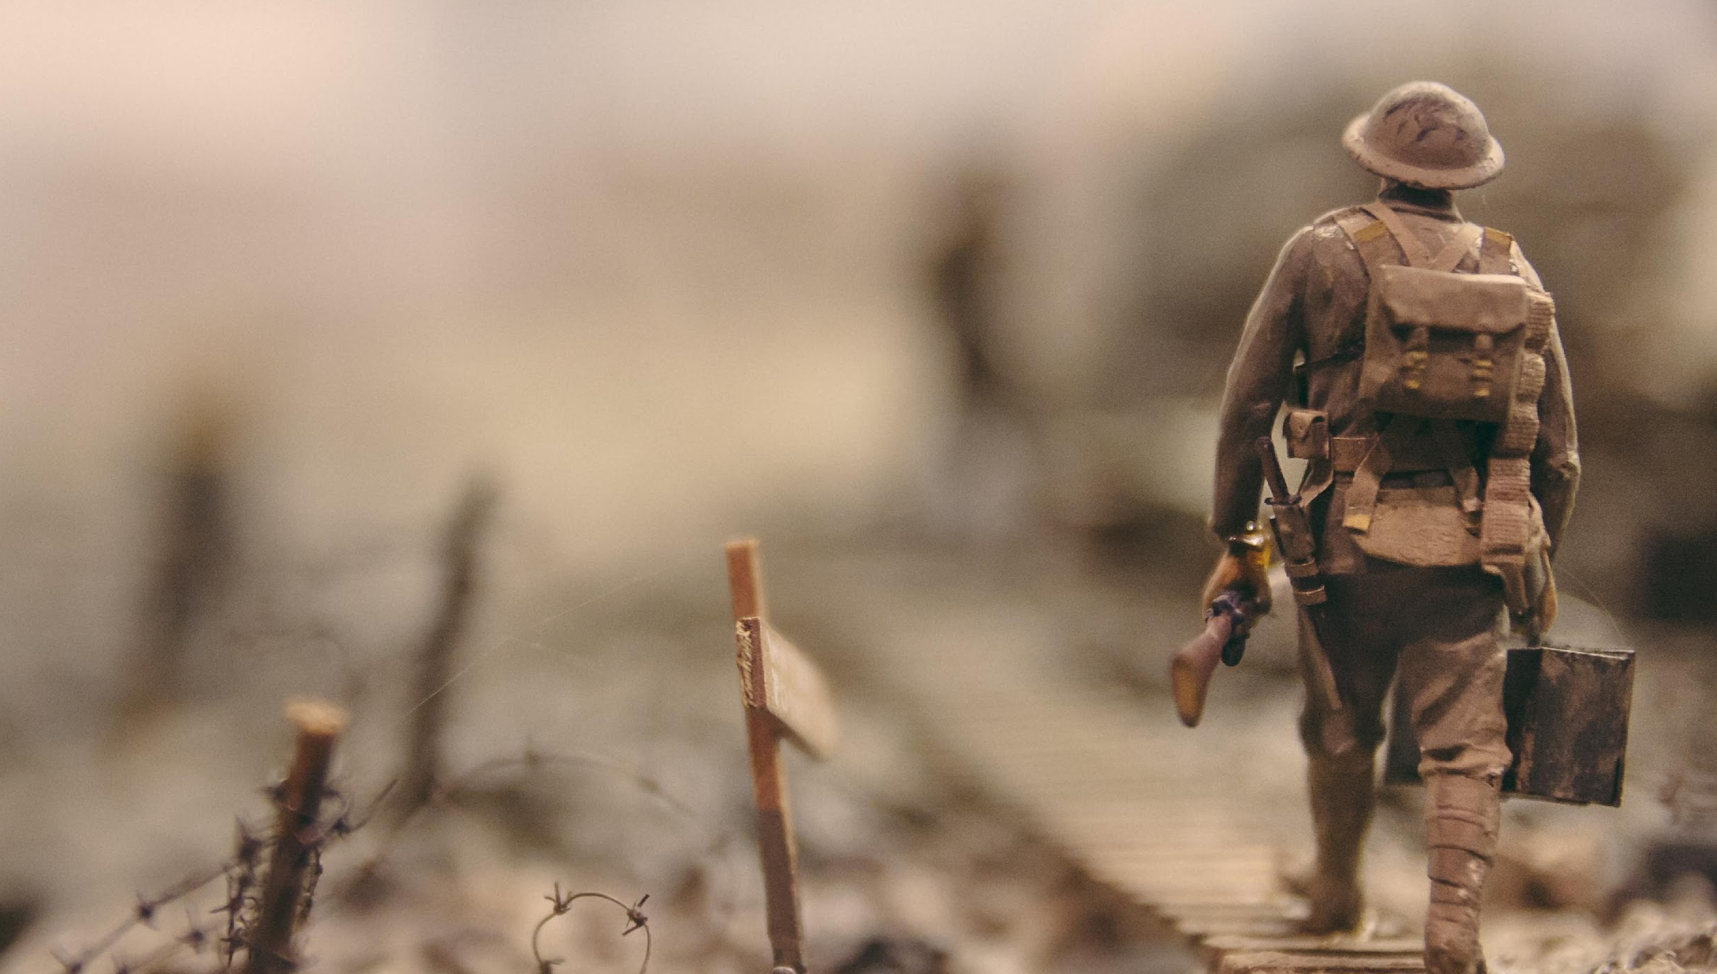
Photo by Stijn Swinnen on Unsplash
Notes:
We have touched upon the lessons in survival that stem from our relationship with nature. There is a deep connection between the protections of the earth and social justice. What affects people in one part of the world affects the entire human family.
(Do not read Image https://pixabay.com/en/family-children-father-mother-1466262/)

Slide 10
the stronger the monster gets
Photo by Stijn Swinnen on Unsplash
Notes:
We have touched upon the lessons in survival that stem from our relationship with nature. There is a deep connection between the protections of the earth and social justice. What affects people in one part of the world affects the entire human family.
(Do not read Image https://pixabay.com/en/family-children-father-mother-1466262/)

Slide 11
Photo by Loverna Journey on Unsplash
Notes:
We have touched upon the lessons in survival that stem from our relationship with nature. There is a deep connection between the protections of the earth and social justice. What affects people in one part of the world affects the entire human family.
(Do not read Image https://pixabay.com/en/family-children-father-mother-1466262/)

Slide 12
it gets smaller and weaker
Photo by Loverna Journey on Unsplash
Notes:
We have touched upon the lessons in survival that stem from our relationship with nature. There is a deep connection between the protections of the earth and social justice. What affects people in one part of the world affects the entire human family.
(Do not read Image https://pixabay.com/en/family-children-father-mother-1466262/)

Slide 13
practice inviting our painful emotions in.
In Practice
Notes:
Welcome to this course, entitled Lessons in Gratitude.
I am Sean Fargo.
I am the Founder of Mindfulness Exercises.com, a former Buddhist monk, speaker and trainer on mindfulness.
The intention of this course is to share teachings in gratitude and to support you in deepening your exploration of gratitude in your life.

Slide 14
Photo by Loverna Journey on Unsplash
Notes:
We have touched upon the lessons in survival that stem from our relationship with nature. There is a deep connection between the protections of the earth and social justice. What affects people in one part of the world affects the entire human family.
(Do not read Image https://pixabay.com/en/family-children-father-mother-1466262/)

Slide 15
“Oh, hello, my old friend.”
Photo by Loverna Journey on Unsplash
Notes:
We have touched upon the lessons in survival that stem from our relationship with nature. There is a deep connection between the protections of the earth and social justice. What affects people in one part of the world affects the entire human family.
(Do not read Image https://pixabay.com/en/family-children-father-mother-1466262/)

Slide 16
If it's sadness

Slide 17
“Ah, sadness, hello, my old friend”

Slide 18
You can do this for any emotion
frustration
anger
sadness
loneliness

Slide 19
“Ah, hello, my old friend.”

Slide 20
Invite it in, and explore, and investigate how does it actually feel in the body?

Slide 21
Instead of fighting our painful emotions, we can start to get acquainted with them, and really cultivate some self-awareness around these difficult emotions.

Slide 22
They're much easier to work with when you stop struggling against them, when you just allow them to be there.

Slide 23
“hello”

Slide 24
Inviting Everyone
Next Video
Notes:
Welcome to this course, entitled Lessons in Gratitude.
I am Sean Fargo.
I am the Founder of Mindfulness Exercises.com, a former Buddhist monk, speaker and trainer on mindfulness.
The intention of this course is to share teachings in gratitude and to support you in deepening your exploration of gratitude in your life.

