Slide 1
Part 1.2 How to Sit in Meditation
Welcome to the Course!
Notes:
Welcome to this course, entitled Lessons in Gratitude.
I am Sean Fargo.
I am the Founder of Mindfulness Exercises.com, a former Buddhist monk, speaker and trainer on mindfulness.
The intention of this course is to share teachings in gratitude and to support you in deepening your exploration of gratitude in your life.

Slide 2
how to sit
Photo by Kelly Miller on Unsplash
Notes:
We have touched upon the lessons in survival that stem from our relationship with nature. There is a deep connection between the protections of the earth and social justice. What affects people in one part of the world affects the entire human family.
(Do not read Image https://pixabay.com/en/family-children-father-mother-1466262/)

Slide 3
Is there a correct posture for meditation?

Slide 4
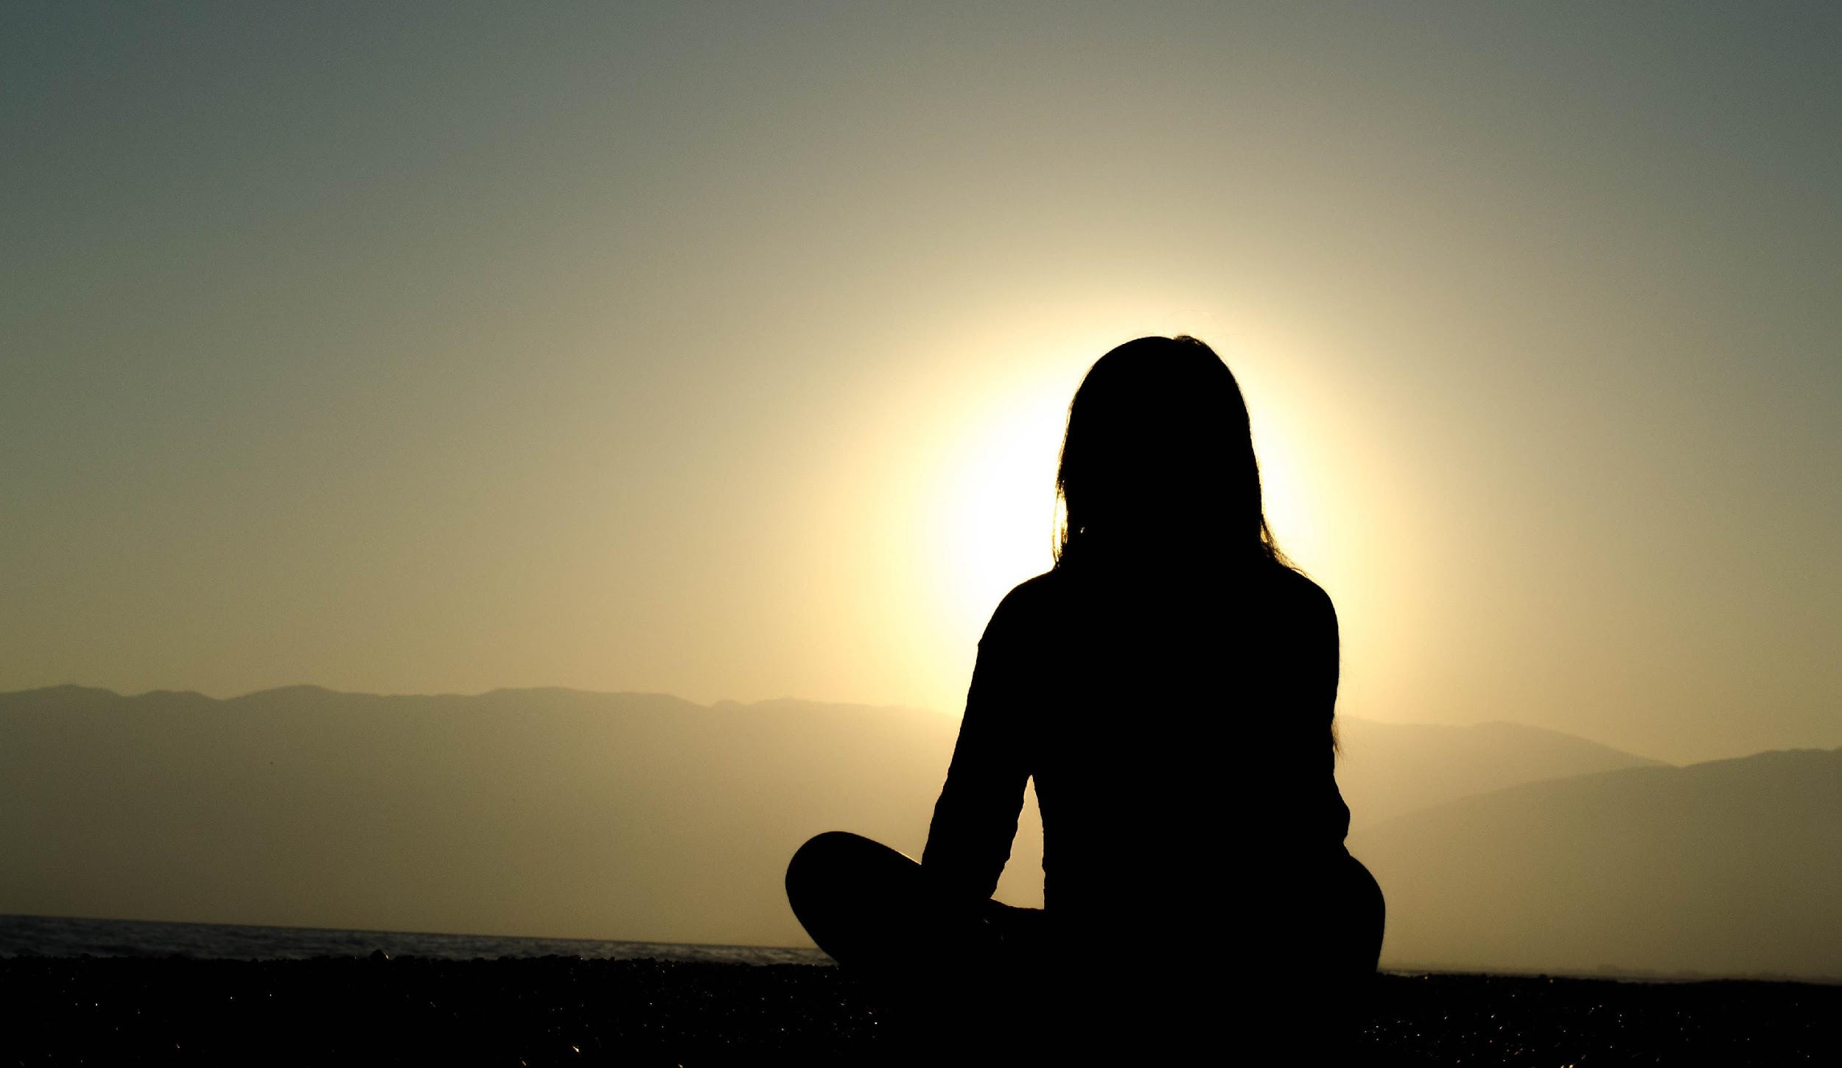
when we see it in the movies, they're doing some sort of funky yoga pose or full lotus posture
Photo by Dingzeyu Li on Unsplash
Notes:
We have touched upon the lessons in survival that stem from our relationship with nature. There is a deep connection between the protections of the earth and social justice. What affects people in one part of the world affects the entire human family.
(Do not read Image https://pixabay.com/en/family-children-father-mother-1466262/)

Slide 5
you don't have to do any funky yoga positions to practice mindfulness

Slide 6
Mindfulness is really more about something we're doing with our mind than something we're doing with our body.

Slide 7
So, you can really do mindfulness in any position
Photo by Erik Mclean on Unsplash
Photo by Madhav Rajesh on Unsplash
Photo by Arek Adeoye on Unsplash
Photo by Andrii Podilnyk on Unsplash

Slide 8
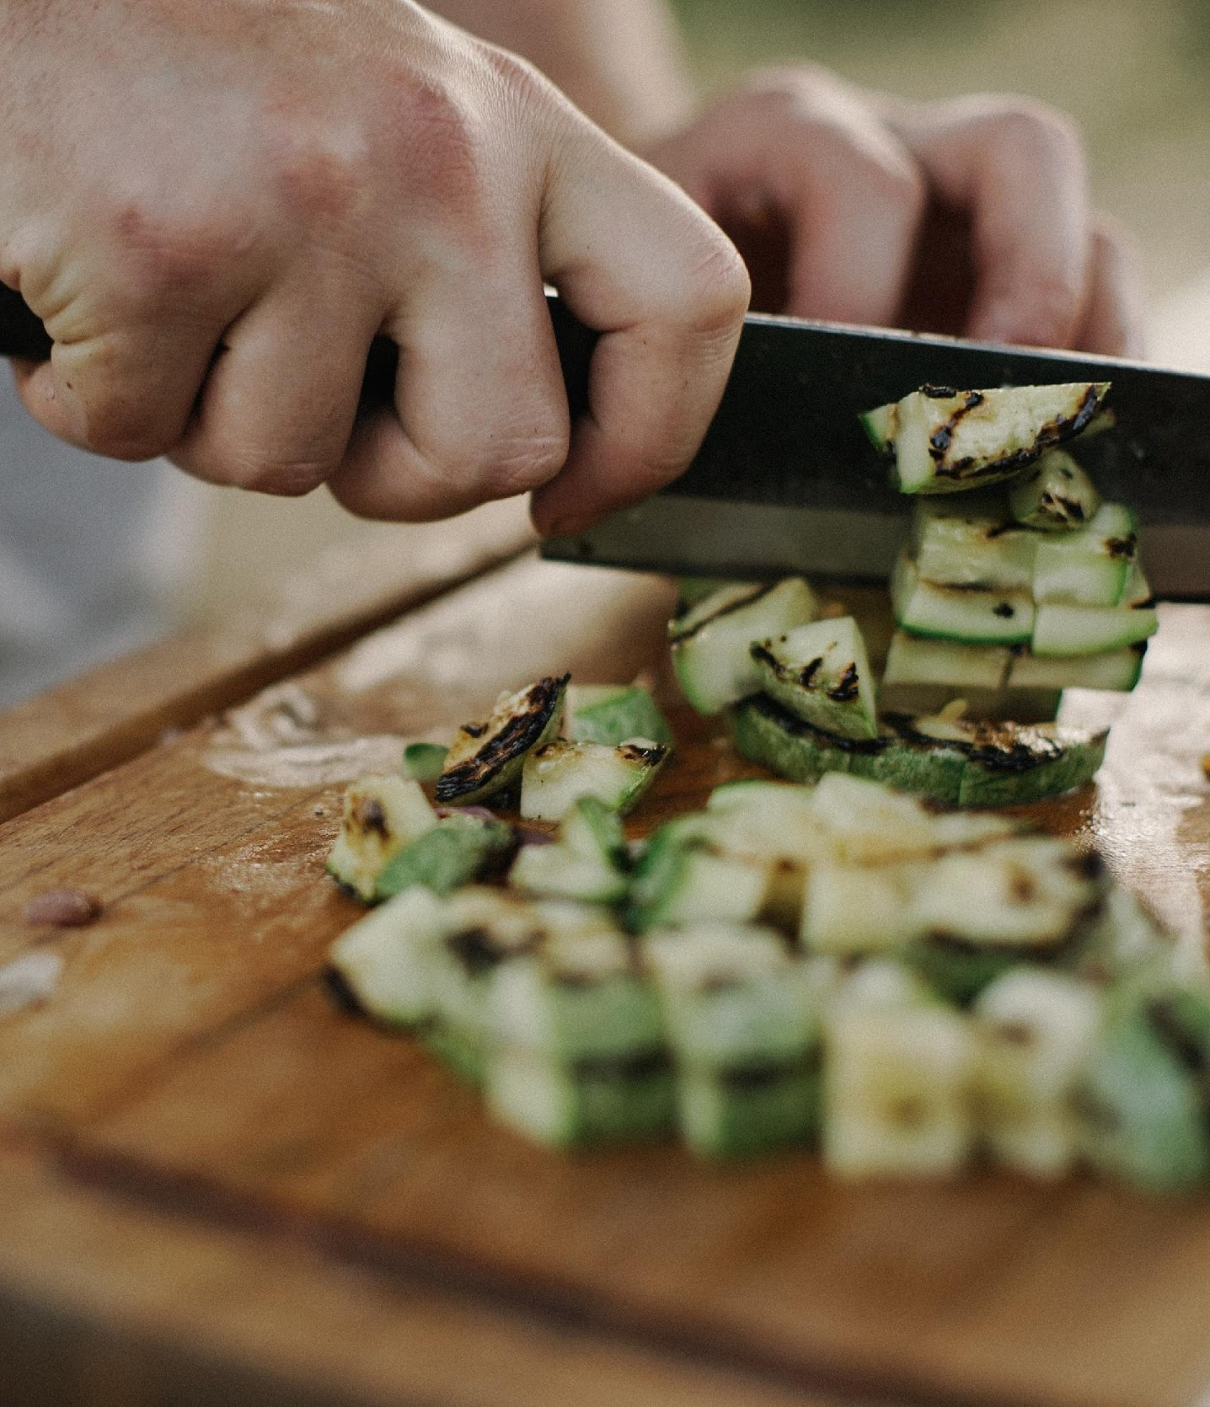
Photo by Max Delsid on Unsplash
Photo by Phuong Tran on Unsplash

Slide 9
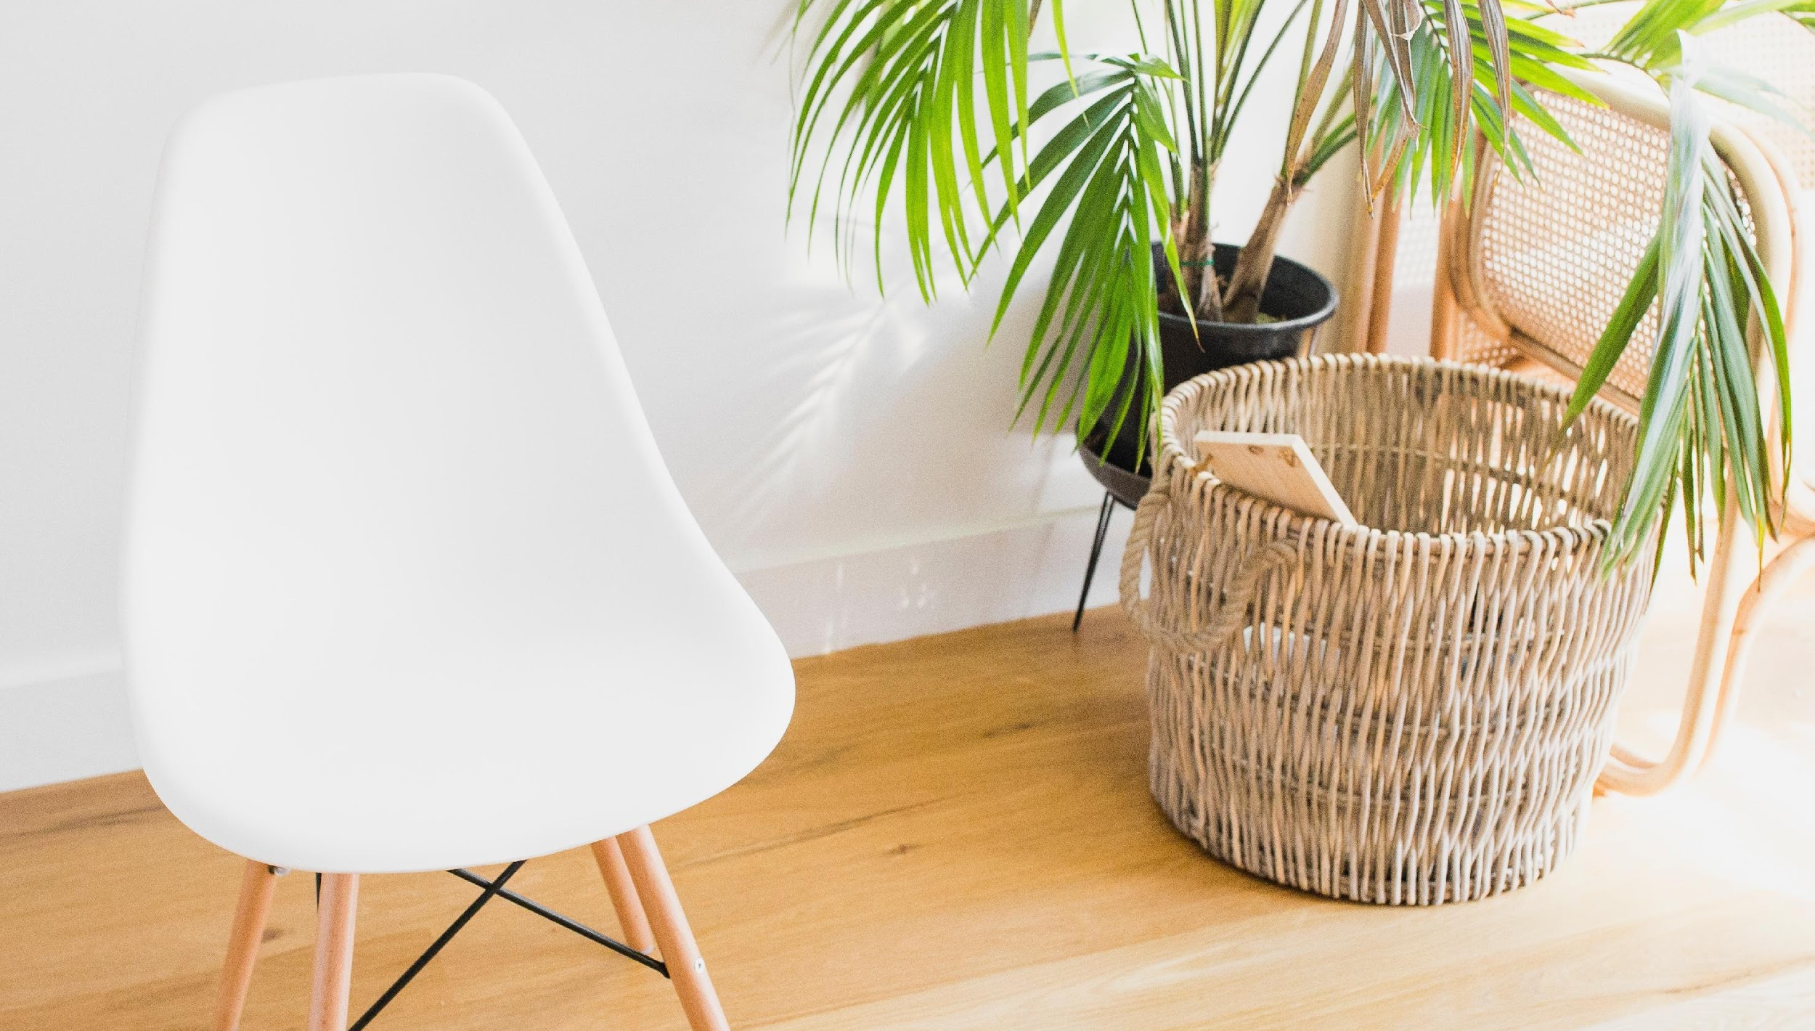
finding a comfortable place to sit
Photo by deanna alys on Unsplash
Notes:
We have touched upon the lessons in survival that stem from our relationship with nature. There is a deep connection between the protections of the earth and social justice. What affects people in one part of the world affects the entire human family.
(Do not read Image https://pixabay.com/en/family-children-father-mother-1466262/)

Slide 10
keep a straight back
Photo by deanna alys on Unsplash
Notes:
We have touched upon the lessons in survival that stem from our relationship with nature. There is a deep connection between the protections of the earth and social justice. What affects people in one part of the world affects the entire human family.
(Do not read Image https://pixabay.com/en/family-children-father-mother-1466262/)

Slide 11
lengthen the spine a bit but we don't want to be too erect.

Slide 12
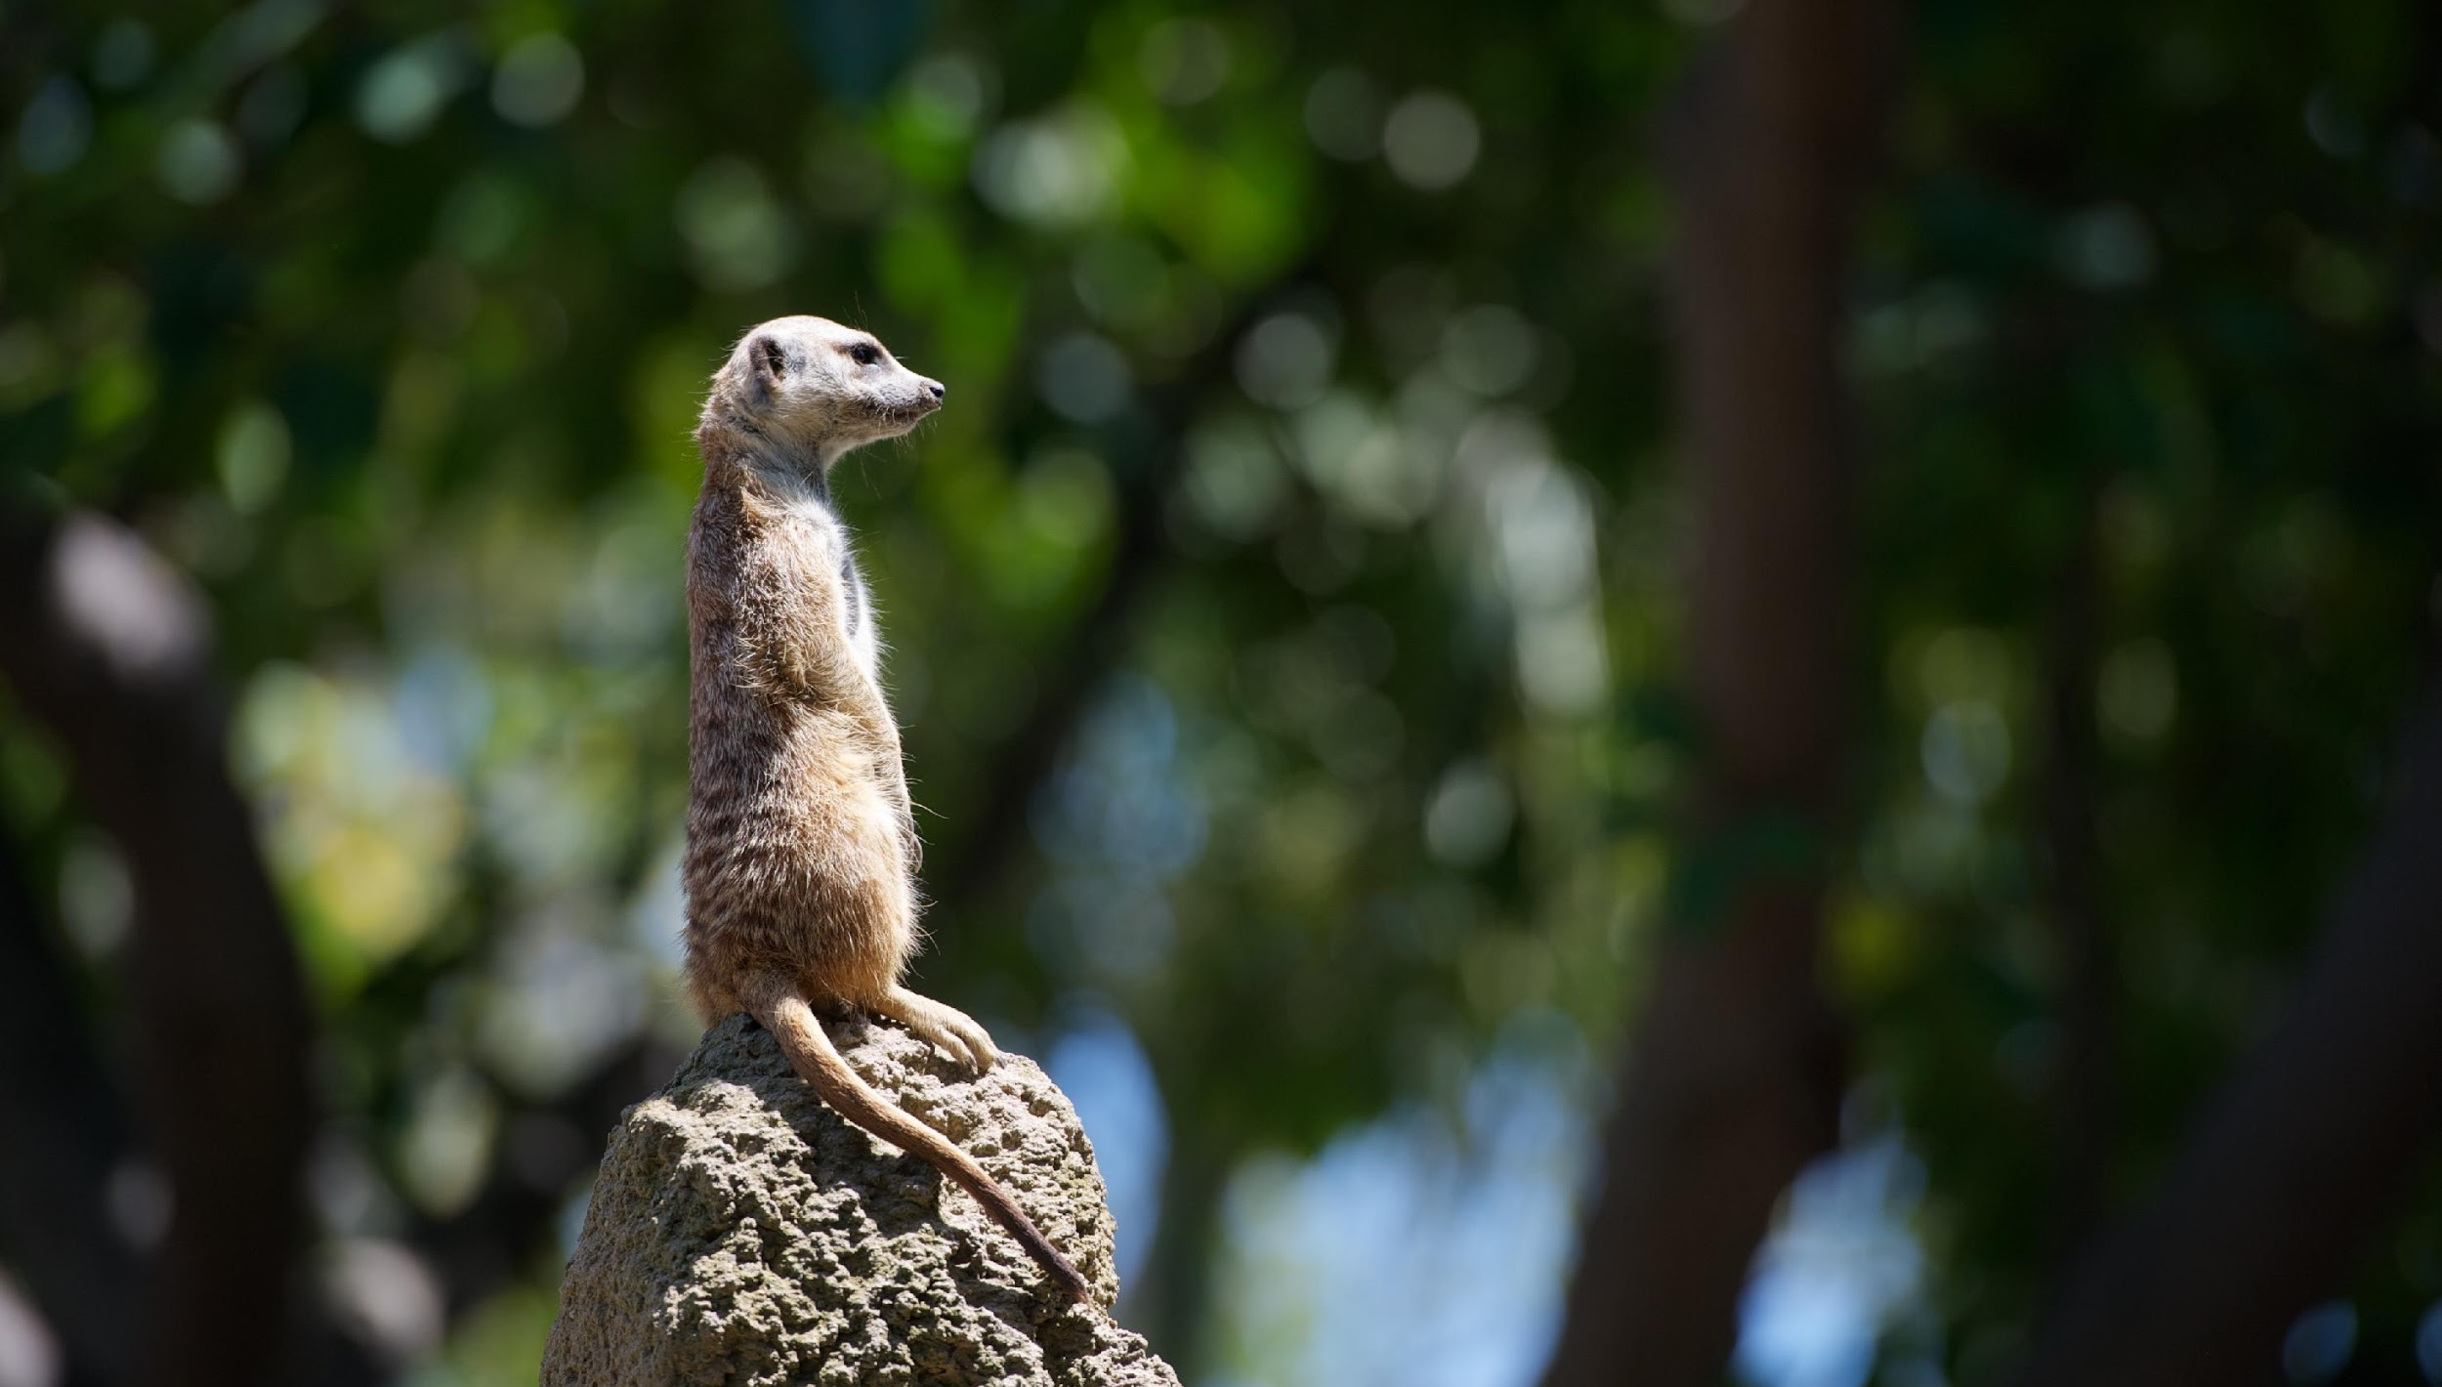
too stiff like this
Photo by Lance Anderson on Unsplash
Notes:
We have touched upon the lessons in survival that stem from our relationship with nature. There is a deep connection between the protections of the earth and social justice. What affects people in one part of the world affects the entire human family.
(Do not read Image https://pixabay.com/en/family-children-father-mother-1466262/)

Slide 13
relaxed at the same time

Slide 14
“alert, yet relaxed”

Slide 15
lengthen the spine to be alert, and then we can relax the shoulders to be relaxed

Slide 16
nice, stable posture
Photo by Clarisse Meyer on Unsplash
Notes:
We have touched upon the lessons in survival that stem from our relationship with nature. There is a deep connection between the protections of the earth and social justice. What affects people in one part of the world affects the entire human family.
(Do not read Image https://pixabay.com/en/family-children-father-mother-1466262/)

Slide 17
you can also do this practice lying down
Photo by Andrii Podilnyk on Unsplash
Notes:
We have touched upon the lessons in survival that stem from our relationship with nature. There is a deep connection between the protections of the earth and social justice. What affects people in one part of the world affects the entire human family.
(Do not read Image https://pixabay.com/en/family-children-father-mother-1466262/)

Slide 18
it can be hard to stay awake if you're doing a lying down meditation practice
Photo by Andrii Podilnyk on Unsplash
Notes:
We have touched upon the lessons in survival that stem from our relationship with nature. There is a deep connection between the protections of the earth and social justice. What affects people in one part of the world affects the entire human family.
(Do not read Image https://pixabay.com/en/family-children-father-mother-1466262/)

Slide 19
if you have some serious physical injury or sitting is just not available to you, feel free to do this lying down

Slide 20
How to set up the proper mental foundation for beginning our meditation practice
Next Video
Notes:
Welcome to this course, entitled Lessons in Gratitude.
I am Sean Fargo.
I am the Founder of Mindfulness Exercises.com, a former Buddhist monk, speaker and trainer on mindfulness.
The intention of this course is to share teachings in gratitude and to support you in deepening your exploration of gratitude in your life.

